Slide 1
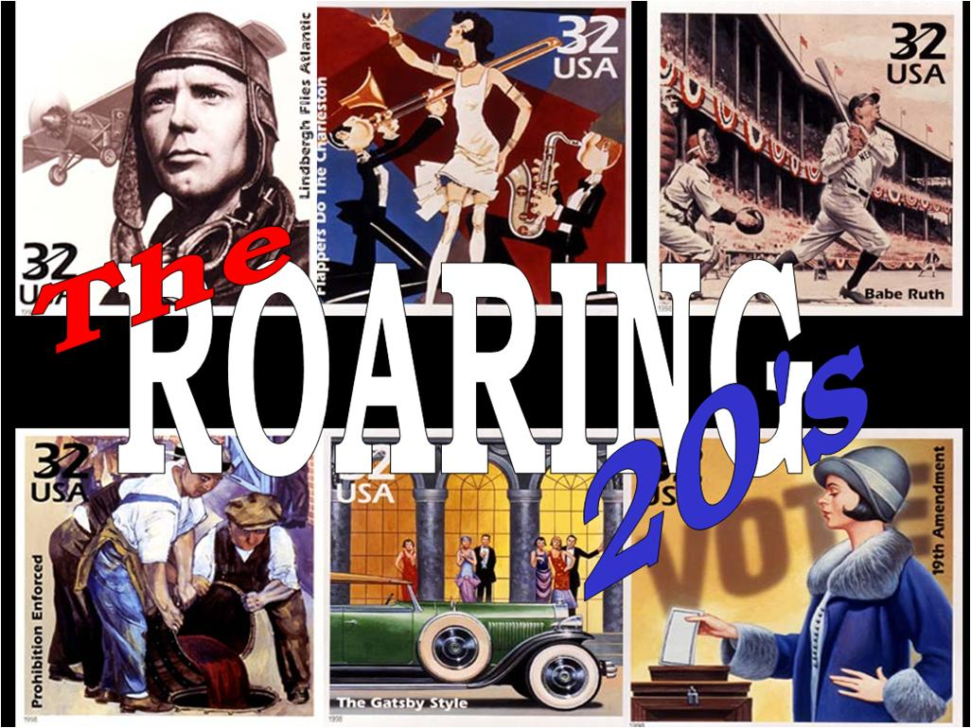
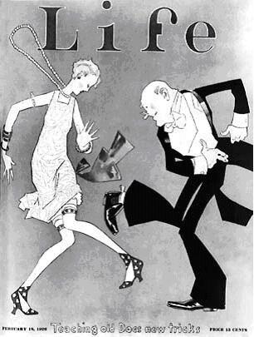
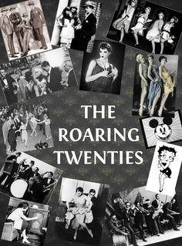
The Roaring 20’s – very prosperous decade, characterize by:
New technology (Cars, planes, electricity, phonographs)
Increase in economy: Booming economy, soaring stock market
Prohibition/organized crime
Advances for women free-spirited youth & African Americans, Expanding cities
Rise in mass media & spectator sports, media, music,
https://www.youtube.com/watch?v=RN7ftyZigYs

Slide 2
Increasing Technology during the 1920’s

Slide 3
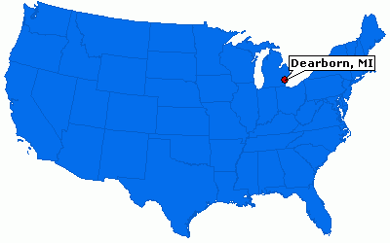
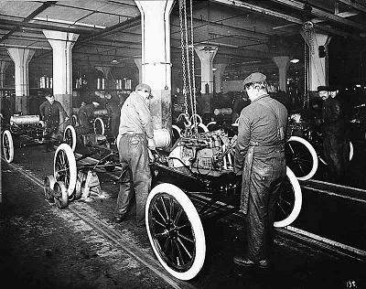
Henry Ford 1863-1947
Born into a wealthy family, Michigan in 1863, Interested in mechanics
He developed his own internal combustion engine in 1896
1903 – he created the Ford Motor Company
Ford’s Goal: build a reliable affordable car
1908 – 1st Model T was built
Opened his factory in 1910 in Michigan
By 1918 half of all cars in U.S. were Ford Model T’s
Ford did NOT invent the car, but he perfected the assembly line
https://www.youtube.com/watch?v=VGWeQ2kIPKY (45:00)

Slide 4
Model T (Tin Lizzie) 1908-1927 –Model T revolutionized life in the US:
Mass production - the first car made by Ford Motor Co. on an assembly line. Before the Model T, cars were made painstakingly by hand.
Mass mobility, people moved to new cities (Mid-West and West Coast)
Growth of areas around cities
Created the American middle class
The Model T, also known as the “Tin Lizzie,” changed the way Americans live, work and travel. Henry Ford’s revolutionary advancements in assembly-line automobile manufacturing made the Model T the first car to be affordable for a majority of Americans. For the first time car ownership became a reality for average American workers, not just the wealthy. More than 15 million Model Ts were built in Detroit and Highland Park, Michigan, and the automobile was also assembled at a Ford plant in Manchester, England, and at plants in continental Europe.
The Model T was an automobile built by the Ford Motor Company from 1908 until 1927. Conceived by Henry Ford as practical, affordable transportation for the common man, it quickly became prized for its low cost, durability, versatility, and ease of maintenance. Assembly-line production allowed the price of the touring car version to be lowered from $850 in 1908 to less than $300 in 1925. At such prices the Model T at times comprised as much as 40 percent of all cars sold in the United States.

Slide 5
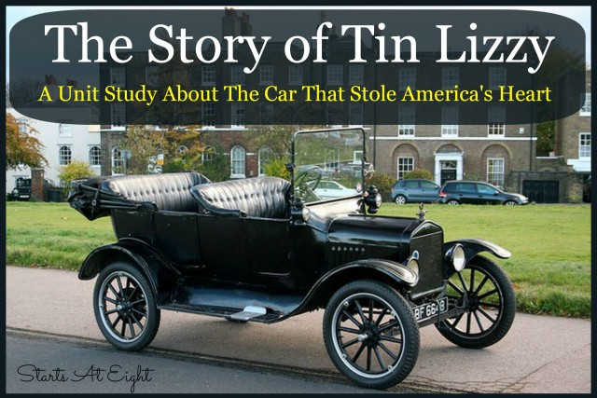
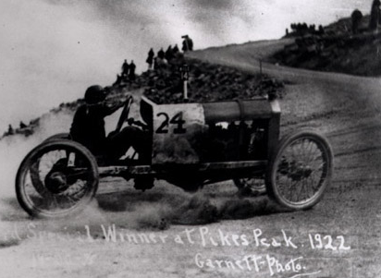
Why was it called the Tin Lizzie?
Priced so that the average American could afford it, Henry Ford sold his Model T from 1908 until 1927. Many also may know the Model T by its nickname, the "Tin Lizzie." But how did the Model T get its nickname?
In the early 1900s, car dealers would try to create publicity for their new automobiles by hosting car races. In 1922, a championship race was held in Pikes Peak, Colorado. Entered as one of the contestants was Noel Bullock and his Model T, named "Old Liz." Since Old Liz looked the worse for wear (it was unpainted and lacked a hood), many spectators compared Old Liz to a tin can.
By the start of the race, the car had the new nickame of "Tin Lizzie." To everyone's surprise, Tin Lizzie won the race.
Having beaten even the most expensive other cars available at the time, Tin Lizzie proved both the durability and speed. The surprise win of Tin Lizzie was reported in newspapers across the country, leading to the use of the nickname "Tin Lizzie" for all Model T cars.

Slide 6
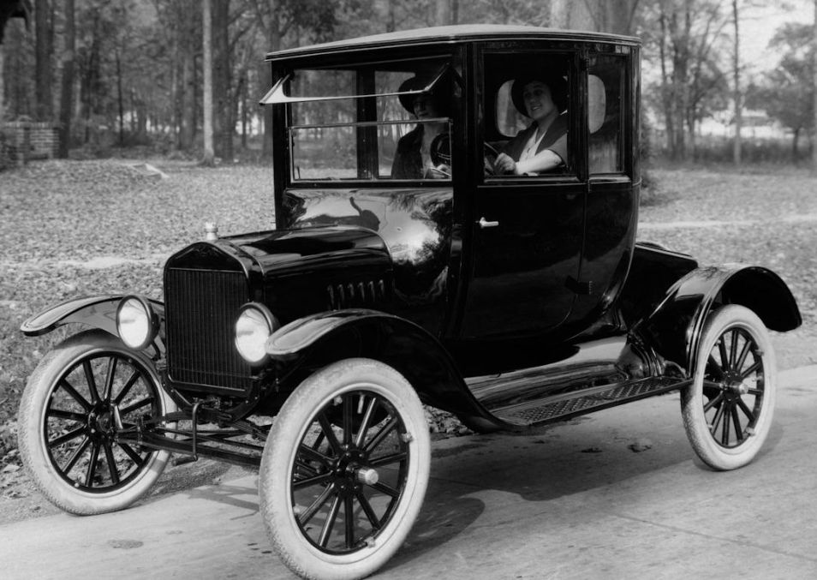
Other impacts of the automobile
New industries emerged: Gas stations, repair shops, motels
Increased amount of paved roads
Need for oil/gasoline drastically increased.
Route 66 (road from Chicago to Los Angeles) was built
Garages or carports were built onto homes
Many cities relied on auto related industries:
Traffic lights, road signs needed to be installed
Akron Oh – Goodyear & Firestone tires
Texas & Oklahoma – oil production
By the late 1920’s 80% of cars in the world were in the U.S.

Slide 7
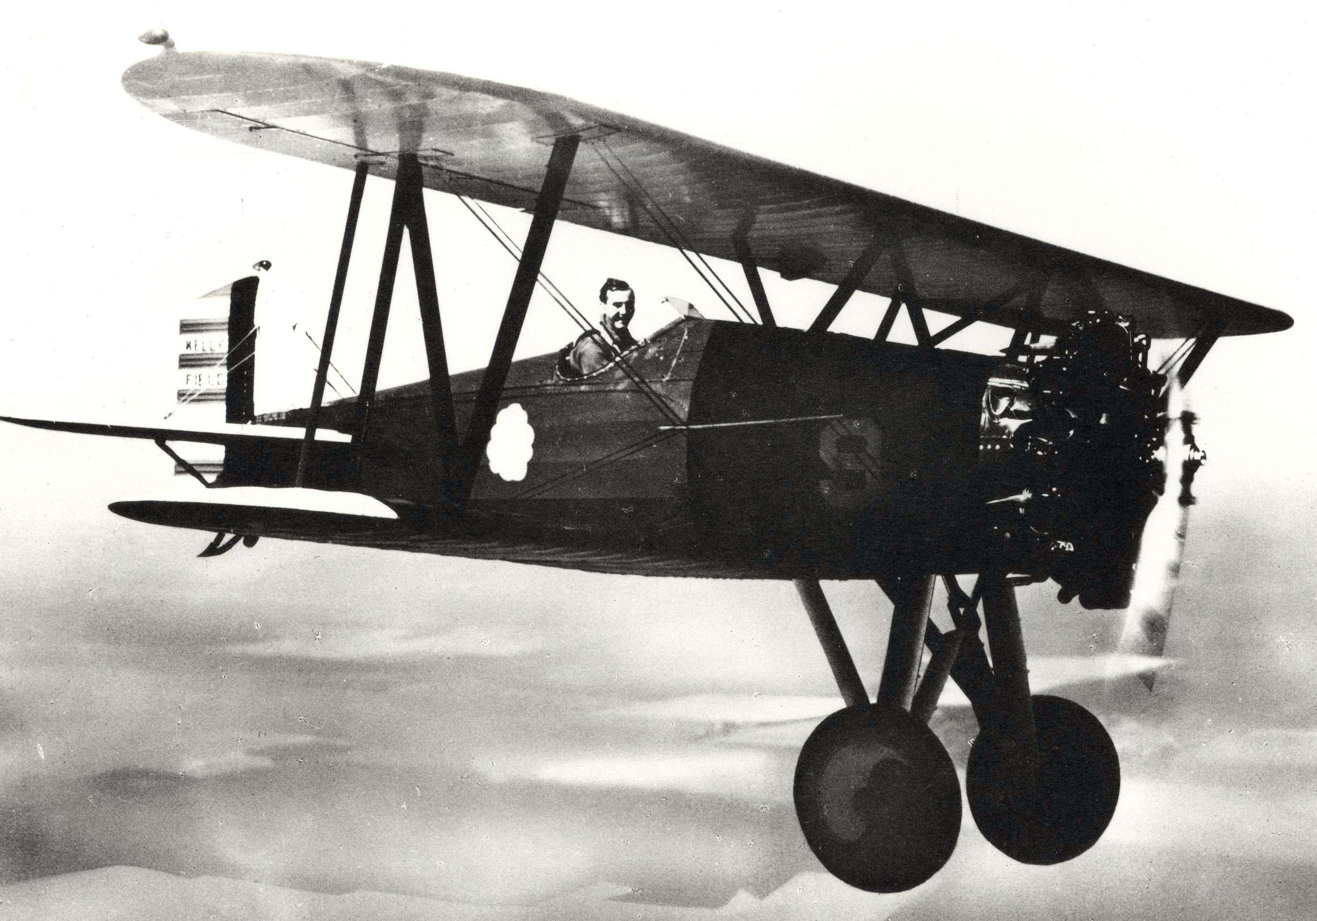
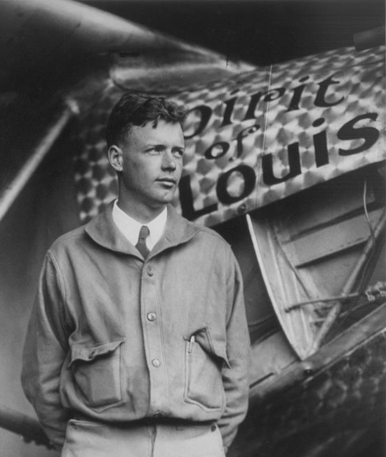
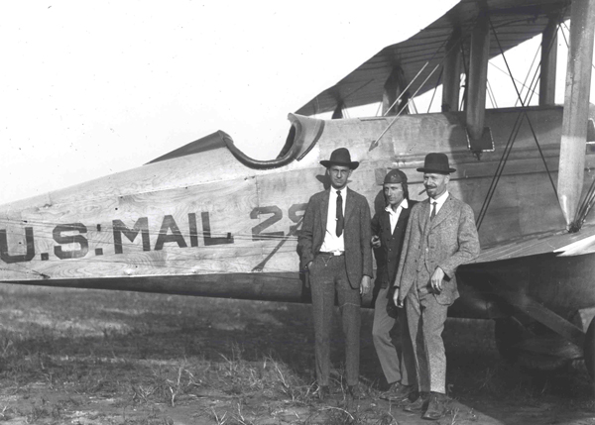
Airline Industry in the 1920’s
Used to carry US mail
Weather forecasting
Passenger flights (very limited areas)
1927 – the Lockheed Company built a single engine plane
1927 - Charles Lindbergh flew the “Spirit of St. Louis” as the first trans-Atlantic flight from NY to Paris.
1932 – Amelia Earhart’s trans-Atlantic Flight from Canada to North Ireland

Slide 8
Friday, November 13, 2015
What were 3 consumer products that became popular during the 1920’s? (Hint: Review from Friday.)

Slide 9
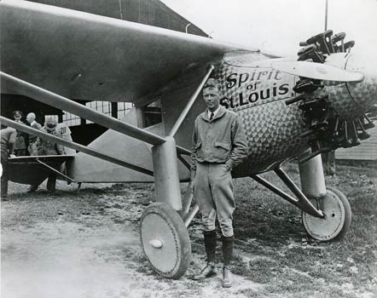
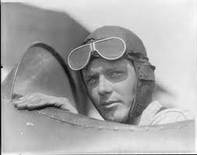
Charles Lindbergh’s Spirit of St. Louis
https://www.youtube.com/watch?v=oR1FkSasydM (53:00)

Slide 10
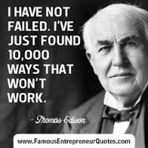
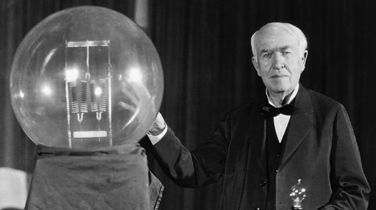
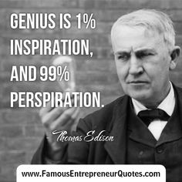
Thomas Edison – “The Wizard of Menlo Park”

Slide 11
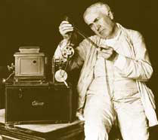
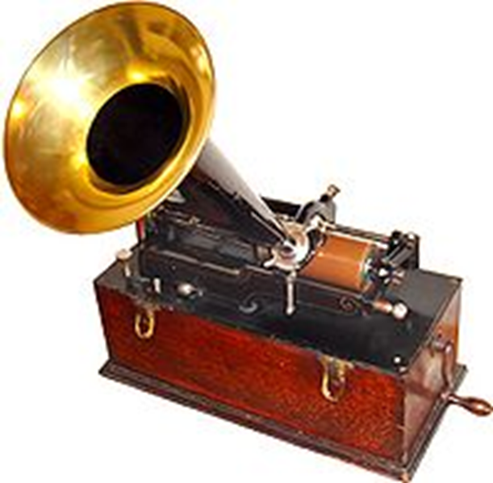
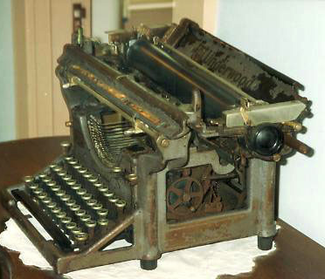
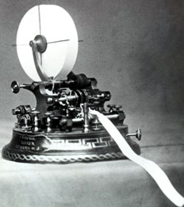
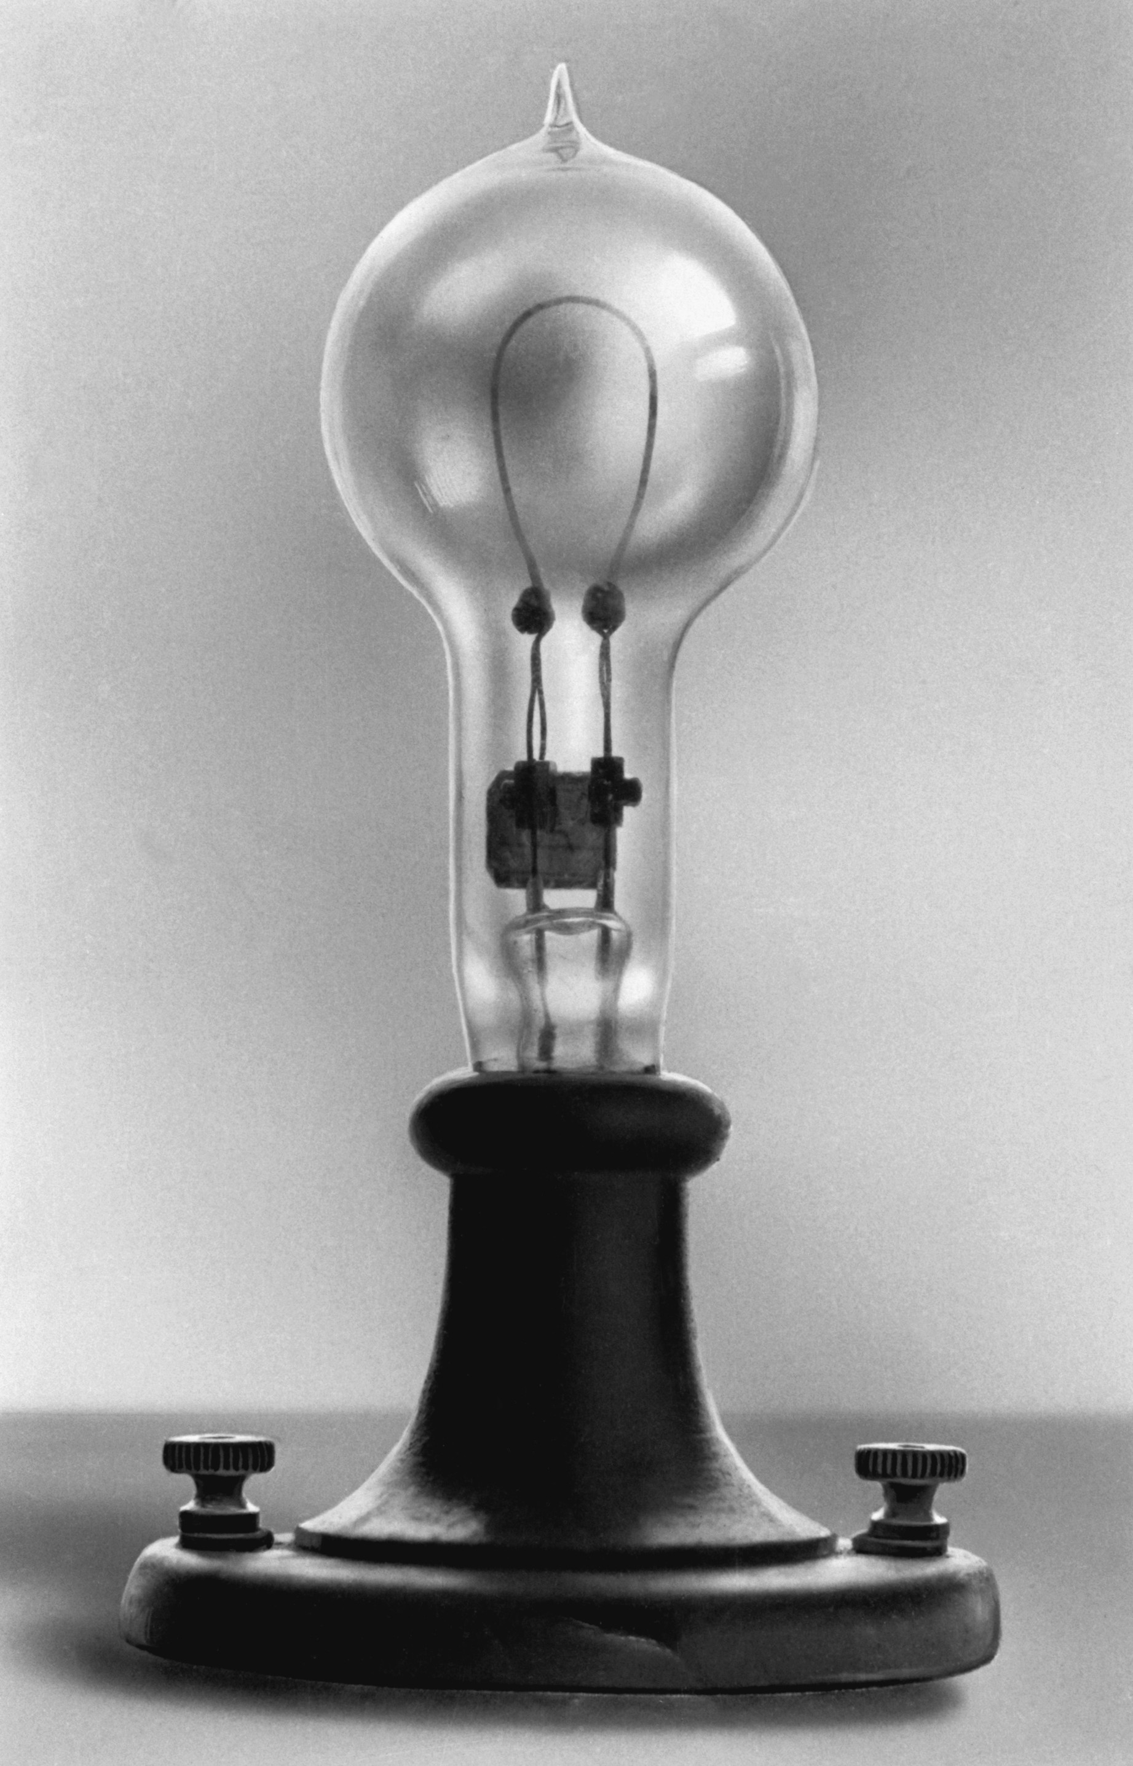
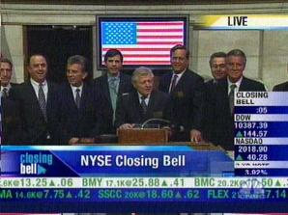
Thomas Edison – famous US inventor
Nickname - Wizard of Menlo Park
Menlo Park – Edison’s research laboratory in NJ
Held over 1,000 patents
Edison employed many brilliant men who did much of the research towards the final invention, but Edison still gets the credit.
Most famous inventions:
Light bulb** (best version)
Phonograph
Motion picture cameras** (improved version)
Stock ticker** (much improved version)
Typewriter** (much improved version)
http://www.history.com/topics/inventions/thomas-edison (2:51)

Slide 12
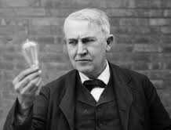
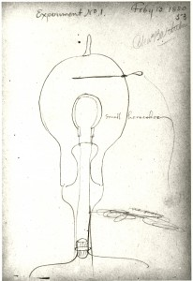
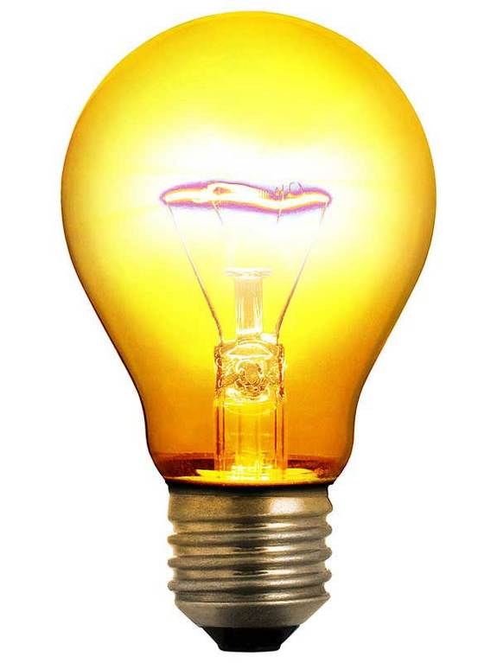
Who really invented the light bulb?
Thomas Edison didn’t invent the light bulb but he produced the 1st commercially viable light bulb
Historians agree that Thomas Edison was not the inventor of the electric light bulb.
Earlier light bulbs were experimented with as far back as 1802; and there were 23 others who had invented light bulbs, some of whom were still working on them at the time of Edison’s work.
Edison’s serious incandescent light bulb research began in 1878.
His experiments involved the fabrication and testing of many different metal filaments.
Three factors in combination are generally recognized as contributing to Edison’s success: 1. durable incandescent material 2. elimination of air from the bulb-a better vacuum and a stronger filament material.

Slide 13
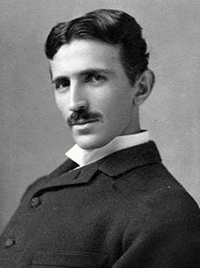
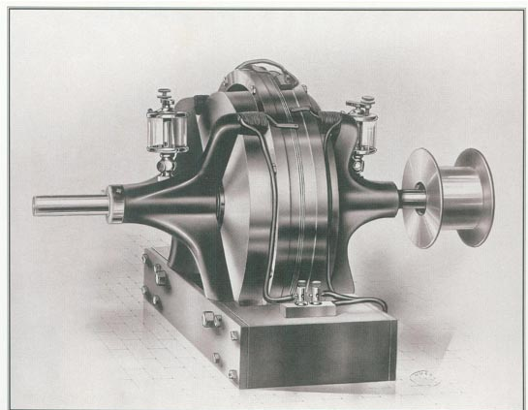
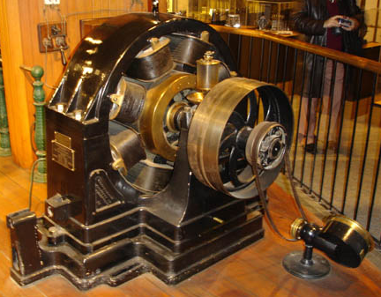
Who is Nikola Tesla?
Nikola Tesla – famous US inventor (born in Croatia 1856, came to the US in 1884)
Worked with Thomas Edison before they parted ways.
He invented:
A/C machine (alternating-current)
X-ray machine
Radio components such as antennas, tuners etc.,Guglielmo Marconi was given credit for inventing the radio itself.
He also contributed to many other inventions dealing, remote control, lights, robotics, lasers, wireless communications.
He worked in alternating current (AC) instead of direct current (DC) which Edison used. (This is where the band AC/DC got its name)
AC Motors can be found in numerous home appliances and applications, including: clocks, power tools, disk drives, washing machines, home appliances, fans, pumps, compressors, many of appliances also use DC motors or a universal (combination of both)
He sold his alternating-current machine patent to George Westinghouse.

Slide 14
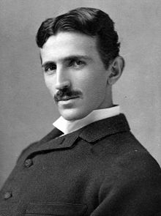
Thomas Edison vs Nikola Tesla
“War of Currents” – (1880’s-920’s), a bitter feud/competition between Edison and Tesla over which type of electric power (AC or DC) was better & safer.
Electricity is a natural phenomenon and so it was not 'invented' but "discovered". Modern day use of electricity is the result of the work of many inventors, scientists, and researchers. Thomas Edison and Nikola Tesla both made major contributions to bringing electricity to people’s homes. Starting in the late 1880s, Thomas Edison and Nikola Tesla were embroiled in a battle now known as the War of the Currents.
Edison developed direct current -- current that runs continually in a single direction, like in a battery or a fuel cell. During the early years of electricity, direct current (shorthanded as DC) was the standard in the U.S. But there was one problem. Direct current is not easily converted to higher or lower voltages. Tesla believed that alternating current (or AC) was the solution to this problem. https://www.youtube.com/watch?v=ZvgVGYzJ300 47:00

Slide 15
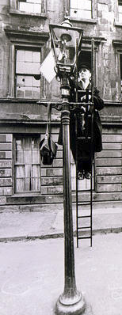
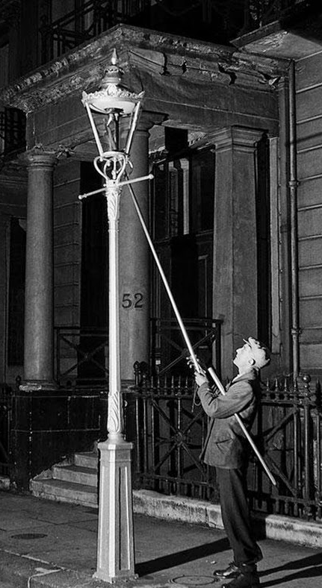
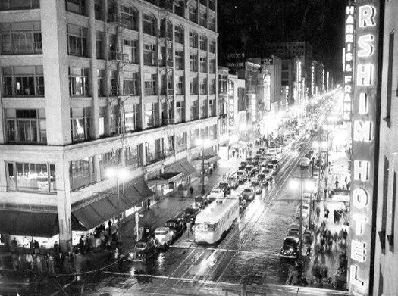
City Street Lamps
Oil lamps were used as city street lights in the 1700’s and early 1800’s
Gas was used to light city street lights from 1820’s – late 1880’s
Early gas street lights had to be lit manually, but many later designs are self-igniting.
1880’s-1920’s the change from gas to electric city street lights
Times Square 1920’s

Slide 16
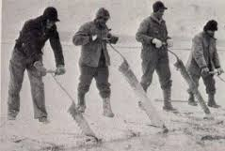
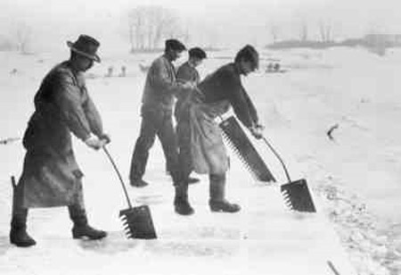
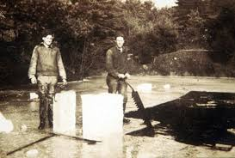
How did people keep food cold before refrigeration
became mainstream in the 1940’s/50’s?
Ice cutting – a winter occupation to collect ice from lakes for storage in ice houses and sale as a pre-refrigeration cooling method. Kept insulated, the ice was preserved for all-year delivery to residential and commercial customers with ice boxes for cold food storage.

Slide 17
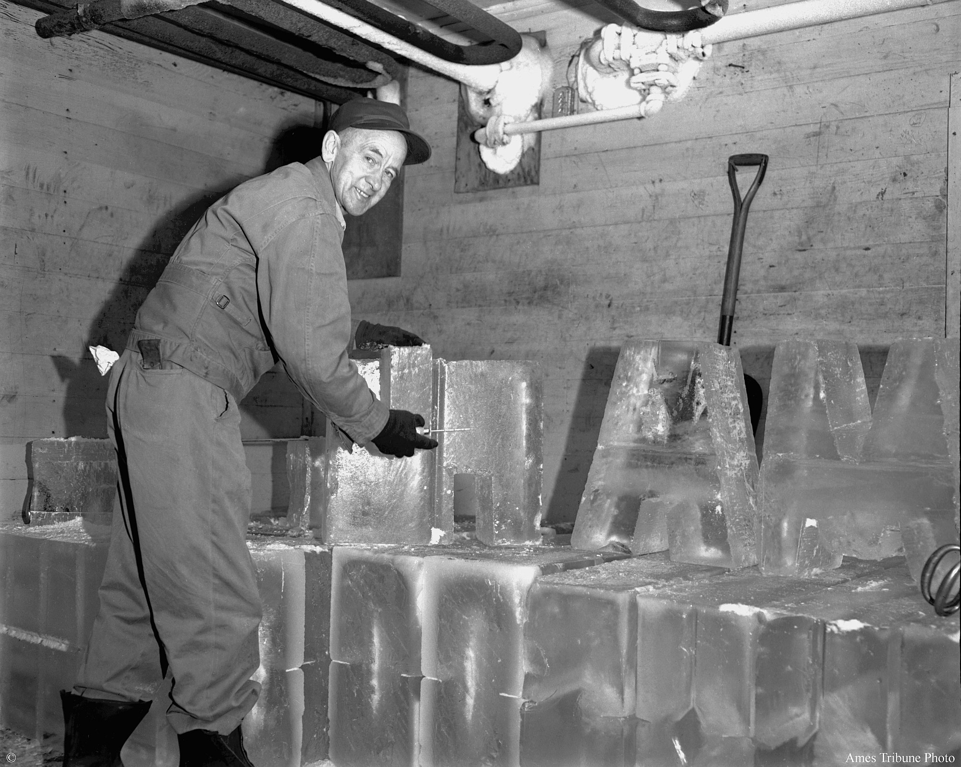
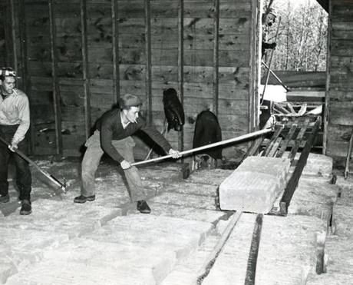
Ice houses –buildings used to store ice throughout the year, prior to the invention of the refrigerator. Most were built underground and close to freshwater lakes, other were buildings which were heavily insulated.
During the winter, ice and snow would be taken into the ice house and packed with insulation, often straw or sawdust. It would remain frozen for many months, often until the following winter, and could be used as a source of ice during summer months.

Slide 18
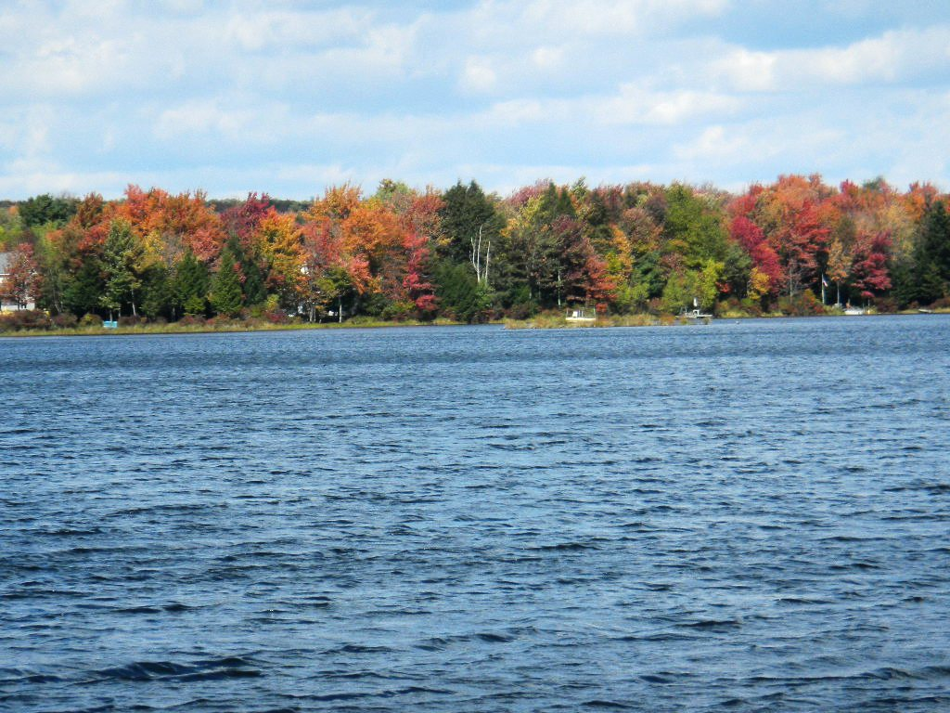
Stillwater Lake, Pocono Mountains PA was the source of the ice delivered to the Wyoming Valley

Slide 19
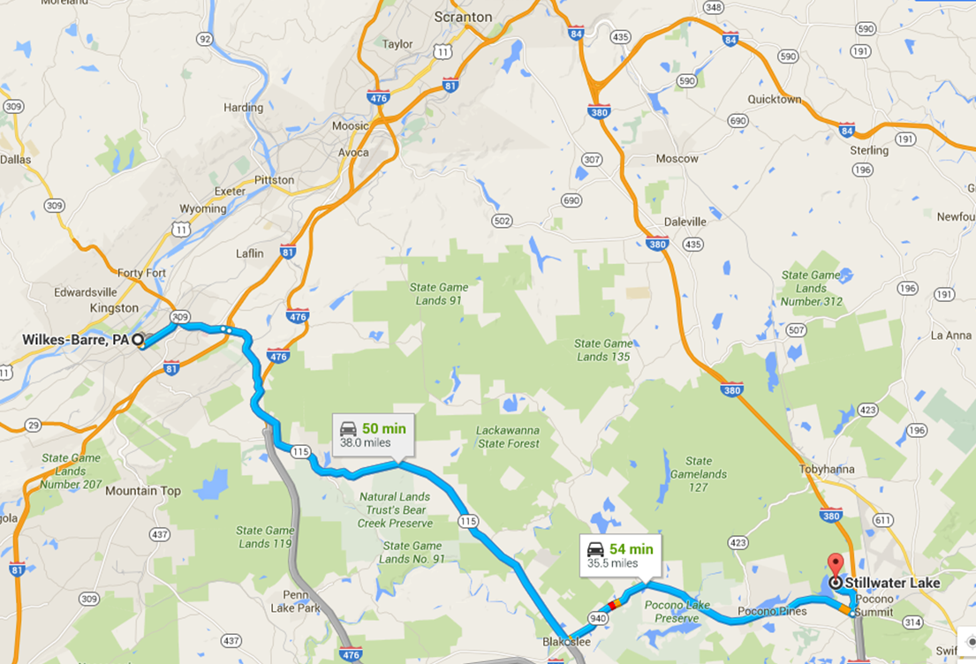
http://www.campminsi.org/about-us/camp-history/ice-harvesting-on-stillwater-lake/61169 12:43

Slide 20
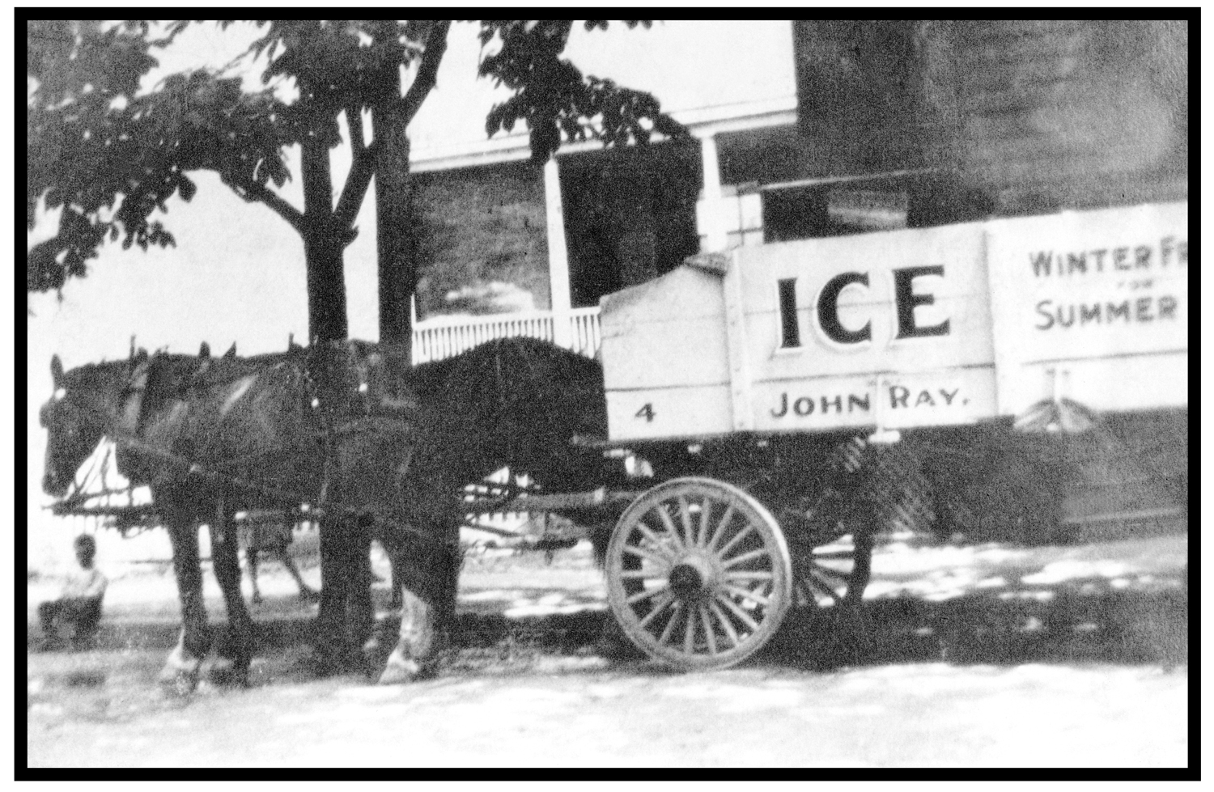
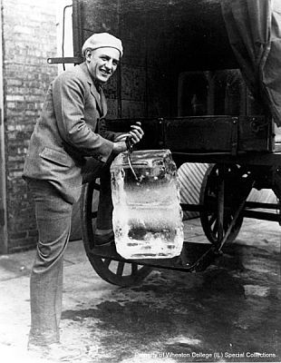
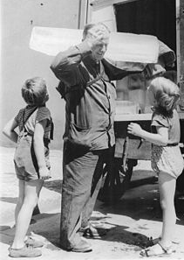
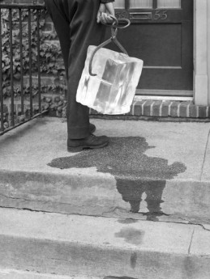
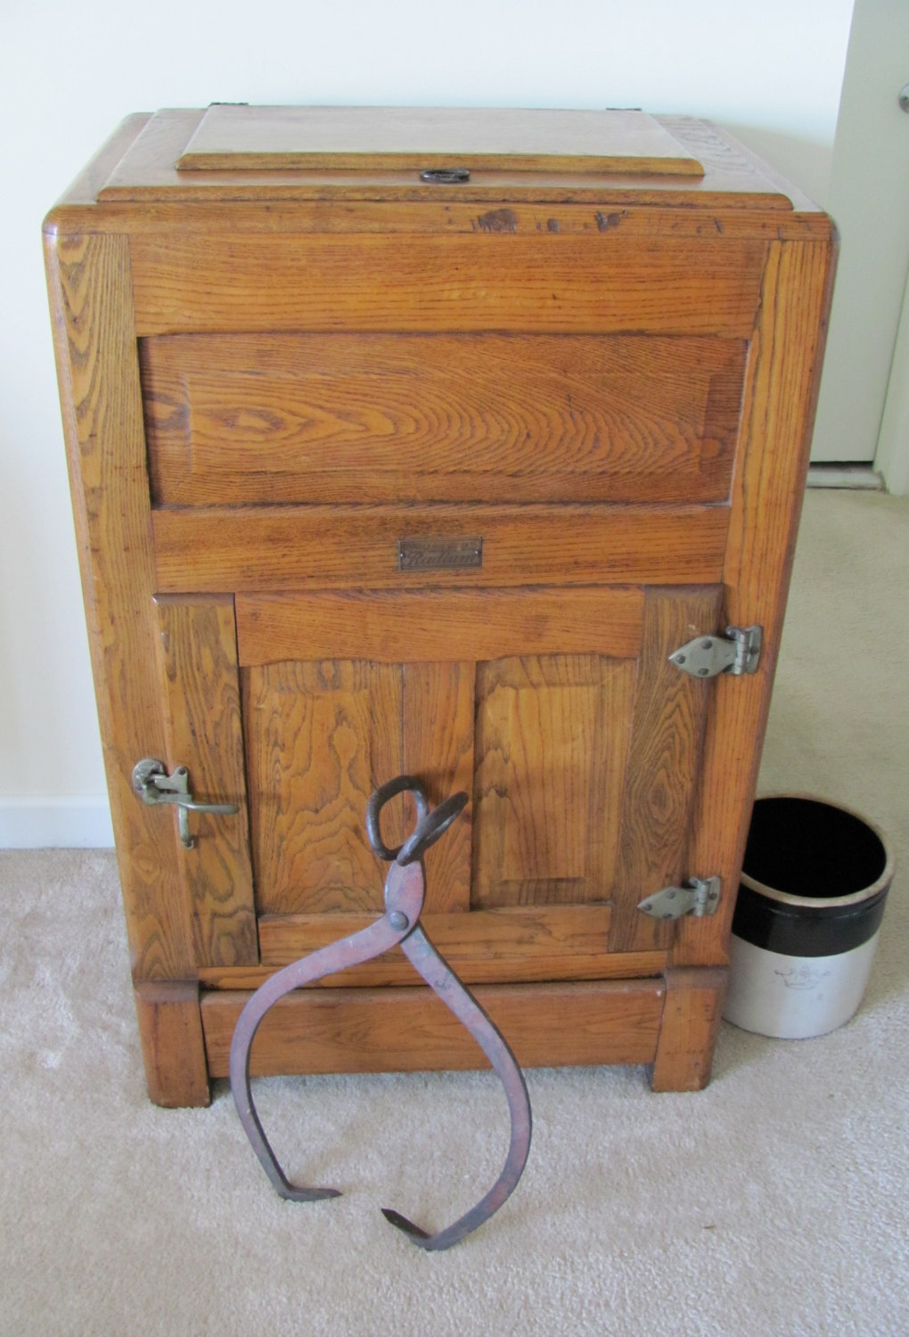
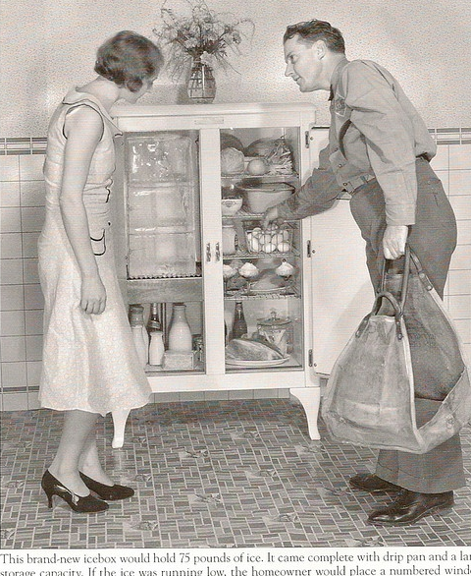
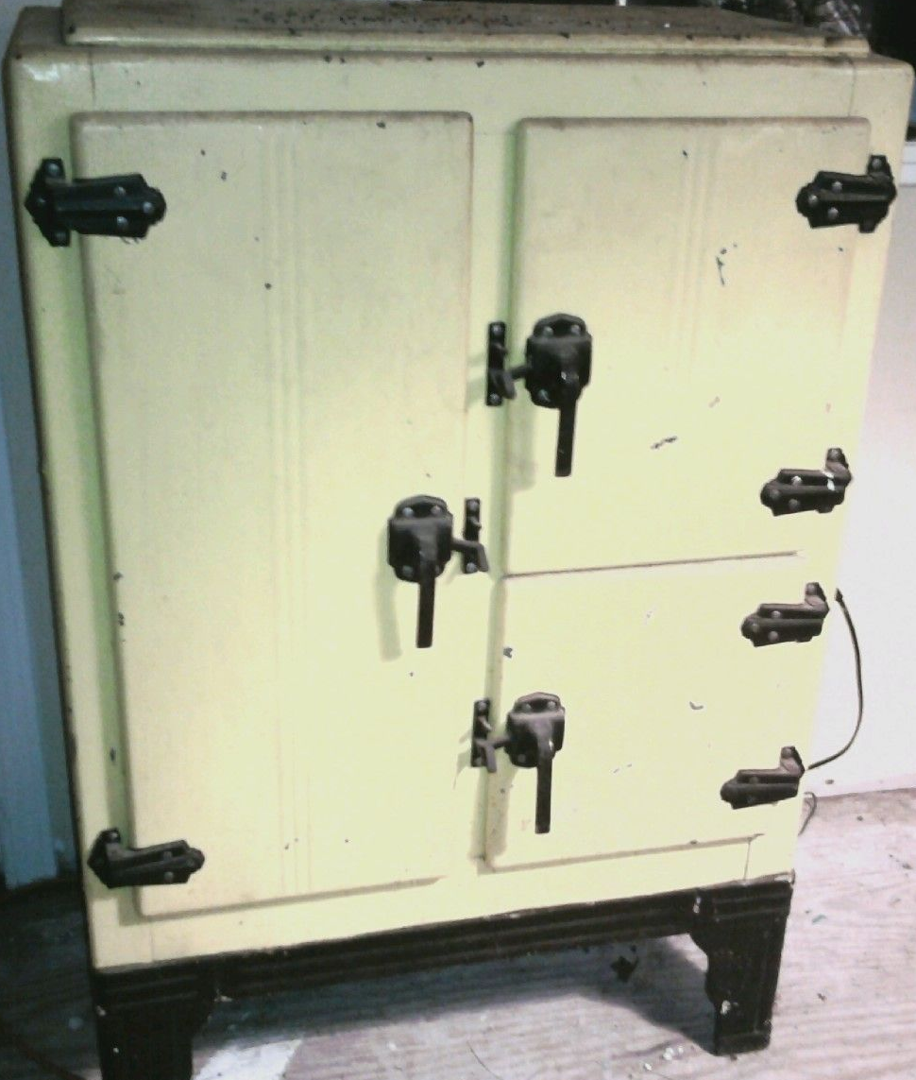
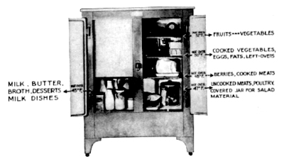
From the late 1800’s-1940’s, icemen would commonly make daily rounds in cities and towns delivering ice for iceboxes before the electric refrigerators.

Slide 21
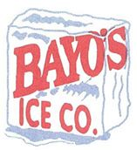
How do we get large quantities of ice today?
Mr. Hanson is the modern-day Ice Man
Bayo’s Ice (Swoyersville) – Among the coolest jobs out there is in the ice business. Corry Hanson is the ice man and he is the owner of Bayo’s Ice Co.
Hanson spends his summer days – and many nights – hauling tons of ice throughout a 10-county area of Northeastern Pennsylvania. To bars and gas stations, hardware stores and diners, Hanson and the rest of the Bayo’s crew travel the region with refrigerated trucks packed full of ice.

Slide 22
Thursday, November 12, 2015
What are 3 consumer goods that people buy today?

Slide 23
Increased Economy during the 1920’s

Slide 24
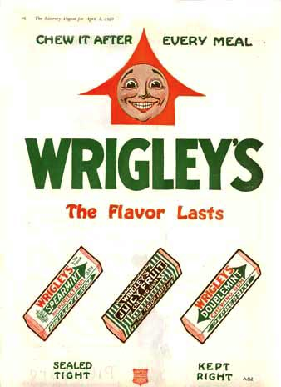
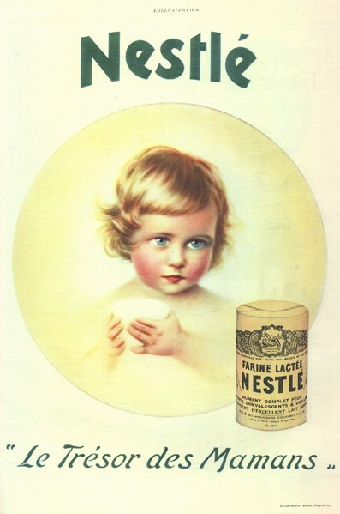
In the 1920’s - America’s standard of living soared
From 1920-1929 The U.S. had 40% of the world’s wealth
Annual average income increased from $500 to $700
Electrical appliances became popular
Advertisements had a huge impact on their popularity.
Consumerism – increased demand for consumer products (cars, appliances etc)

Slide 25
Reasons why the economy grew rapidly in the 1920’s
Growing US population
Abundance of natural resources (coal, timber, ranching, oil)
WW1 profits from weapons and supply sales
Government policies – low taxes, less gov’t control, high tariffs on imports
New industries (cars, planes, appliances)

Slide 26
During the early 1900’s, many businesses realized that in order to make huge profits they needed to open more stores. With the mass production of trucks and new roads and highways being built, this allowed for businesses to be able to ship their products to all of their stores. This brought on the rise of the Chain Stores
Chain stores – opened numerous locations nationwide, they bought inventory in huge quantities and sold at very low prices. (Woolworths, A&P)

Slide 27
Installment Loans – buying products on credit
Banks devised a way for consumers to afford expensive items
They purchased with the promise to pay over a long period of time.
Stores promoted buying on credit.

Slide 28
During the immigration era of the 1800’s and 1900’s alcohol consumption was rapidly increasing.
It led to many of the problems in cities throughout the US.
Many reformers were trying to stop the manufacturing, selling and consumption of alcohol in the US. This was known as the temperance movement.
Reformers blamed alcohol for:
Family violence.
Injuries at work
Car accidents
Temperance movement:
a social movement (late 1800’s-early 1900’s) urging the banning of alcohol
3 Key groups:
Woman's Christian Temperance Union
Anti-Saloon League – religious groups from the south and rural north
Prohibition Party – a political party

Slide 29
Friday, November 13, 2015
How are people able to buy expensive products that they don’t have the money for? (Hint: Review from last class.)

Slide 30
The booming stock market during the 1920’s

Slide 31
During the 1920’s the economy was excellent
Americans were scrambling to get into the stock market, the profits seemed so guaranteed
Even banks used customers' money (without their knowledge) to invest in the stock market. With the stock market prices upward bound, everything seemed wonderful.
By spring of 1929, there were signs that the economy might be headed for a serious setback. Steel production went down; house construction slowed; and car sales slowed.
But the market surged ahead during the summer of 1929. From June through August, stock market prices reached their highest levels to date.
The stock market boomed, many invested everything they had
The stock market made many new millionaires.

Slide 32
What is a stock market?
Why was a stock market created? Why would someone want to give up part of ownership of their business? (Personal loan=Interest, personally liable) vs (Corp=no payback, not liable)
What if you wanted to open a business where would you get the money you need for a building, equipment and working capital? Who would you borrow it from?
Corporation – a business that is owned by its shareholders (stockholders)
Stockholder (shareholder) – someone who owns shares of stock in a corp.
Shares of stock – represents a % of ownership in a corp.
Dividend – money paid by a corp. to its shareholders from their profits
Let’s say your parents and grandparents loan you the money and you give them shares of stock as ownership in your business.
Lets say you issue 100 shares of stock at $100/share
60 shares – you purchase for $6,000
20 shares – your father purchases for $2,000
10 shares – your uncle purchases for $1,000
10 shares – your cousin purchases for $1,000
That’s a total of $10,000 you now have to open your business
You will own 60% of your business and are the controlling shareholder
Most big companies became public corporations by issuing stock (offering their stock for sale to raise money to expand their business and increase profits)

Slide 33
The first stock exchange in Britain was the London Stock Exchange in 1773.
Britain still had control of the colonies in America and was trading regularly.
The first stock exchange in the American colonies began in Philadelphia in 1790.
Stock exchange – marketplace where investors could buy/sell stock to make a profit.
The stock exchange in NY opened in 1792 and was located on the corner of Wall St and Broadway.
The NY stock market continued to grow throughout the 1800’s
By the early 1900’s many people amassed a fortune in the stock market.
This was a way for investors to make huge amounts of money without doing any work.

Slide 34
NY Financial District (Lower Manhattan)
NY Stock Exchange “Wall Street” (Manhattan, NYC) – world’s largest stock market.
The sculpture depicts a bull, the symbol of aggressive financial optimism and prosperity

Slide 35
Buying on Margin
When someone did not have the money to pay the full price of stocks, they could buy stocks "on margin."
Buying on Margin – risky investment to borrow money from stockbrokers to buy stock
A buyer would put down some of his own money, but the rest he would borrow from a broker. In the 1920s, the buyer only had to put down 10 to 20 % of his own money and thus borrowed 80 to 90 percent of the cost of the stock.
Buying on margin could be very risky. If the price of stock fell lower than the loan amount, the broker would likely issue a "margin call," which means that the buyer must come up with the cash to pay back his loan immediately.
In the 1920s, many people hoped to make a lot of money on the stock market, bought stocks on margin. Confident in what seemed a never-ending rise in prices, many of these speculators neglected to seriously consider the risk they were taking.

Slide 36
Most Americans investors did not know how to invest.
They thought stock prices would rise forever and continue to make them money.

Slide 37
Monday, November 16, 2015
Why do you think alcohol became illegal during the 1920s?

Slide 38
Terms for Quiz on Wednesday
Buying on margin Model T Consumerism Prohibition Corporation Stock exchange Henry Ford Temperance Movement Installment Loans Thomas Edison

Slide 39
Prohibition & Organized Crime during the 1920’s

Slide 40
In 1919 an amendment was added to the Constitution, it took effect Jan 1920.
Prohibition – period of time (1920-33) when alcohol was “Prohibited” in the US. It consisted of 2 parts:
18th Amendment – law banning the manufacture & sale of alcohol.
Volstead Act – an act of Congress (1919) that enforced the 18th Amendment. It was introduced by Andrew Volstead.
The 18th Amendment and the Volstead Act are not the same, together they made up Prohibition. The 18th Amendment established the Prohibition of "intoxicating" (alcoholic) beverages in the US, but the Volstead Act was necessary to define what the amendment meant by “intoxicating” and gave the government the legal right to enforce the law.
The 18th Amendment only forbade the “manufacture, sale and transportation of intoxicating liquors”—not their consumption. By law, any wine, beer or spirits Americans already had before January 1920, was theirs to keep and enjoy in the privacy of their homes.
Most people only a few bottles, but some affluent drinkers built cavernous wine cellars and even bought out whole liquor store inventories to ensure they had healthy stockpiles of legal hooch. For many immigrants, alcohol was a part of their culture (Irish, Italians, French).

Slide 41
Prohibition was supposed to solve societies problems but it backfired. It caused many new problems such as:
Organized crime (gangsters), violence, bootlegging & speakeasies

Slide 42
Tuesday, November 17, 2015
What were 3 problems with Prohibition?

Slide 43
Speakeasies – illegal, secret bars during Prohibition
The Roaring Twenties began on a dry note on January 29, 1920, at 12:01 a.m. when the 18th Amendment went into effect. The Anti-Saloon League of New York and others who wanted to make the sale and manufacture of alcohol illegal — thereby combating the related moral and social ills associated with drinking — had successfully lobbied Congress to pass the amendment. Prohibition had begun.
As law enforcement officials shut down saloons across the country, speakeasies — illegal bars — sprouted up quickly. They were given their unique name for the need to whisper, or "speak easy," as patrons attempted to cross their illegal thresholds. A secret knock, password or handshake could get a prospective drinker through a door that appeared to lead to an ordinary apartment, deli, tailor, or soda shop. Once inside, however, there was plenty of drinking and entertainment, including torch singers, cabaret singers, and vaudeville acts.
Most speakeasies were often just a hidden room with barely drinkable booze - were mostly run by gangsters. By 1925, in New York City alone, there were anywhere from 30,000 to 100,000 speakeasy clubs

Slide 44
During Prohibition, cocktails were still consumed illegally in speakeasies. The quality of liquor available during Prohibition was much worse than previously. Since gin does not require aging and is as easier to produce than whiskey.
If not made properly illegal liquor could be toxic. Those desperate enough to drink it also ran the risk of being struck blind or even poisoned. Tainted booze may have killed more than 10,000 people before the repeal of the 18th Amendment
Bathtub-Gin – poor quality homemade liquor made during prohibition
The common metal or ceramic bathtub used at the time would have been ideal to make homemade gin, hence the name, 'bathtub gin'. Many gin cocktails owe their existence to bathtub gin, as they were also created in order to mask the unpleasant taste. Sweet cocktails were easier to drink quickly, an important consideration when the establishment might be raided at any moment.

Slide 45
Bootlegging – illegal manufacture, sale or transportation of alcohol
It is believed that the term "boot-legging" originated during the American Civil War, when soldiers would sneak liquor into army camps by concealing pint bottles within their boots or beneath their trouser legs.
The term "bootlegging" was popularized when thousands of city dwellers would sell liquor from flasks they kept in their boot leg all across major cities and rural areas.
The term "rum-running" most likely originated at the start of Prohibition in the United States (1920–1933), when ships from Bimini in the western Bahamas transported cheap Caribbean rum to Florida speakeasies. But rum's cheapness made it a low-profit item for the rum-runners, and they soon moved on to smuggling Canadian whisky, French champagne, and English gin to major cities like New York City and Boston, where prices ran high. It was said that some ships carried $200,000 in contraband in a single run.

Slide 46
On January 16, 1920, scores of thirsty Americans took to the streets to buy their last legal drinks from liquor stores and saloons. The United States officially became a “dry” country the following day, when the 18th Amendment outlawing “the manufacture, sale or transportation of intoxicating liquors” took effect.
A bar on the eve of prohibition

Slide 47
The Untouchables – a group of US federal agents created to enforce prohibition laws
They were led by Eliot Ness, who, from 1929 to 1931, worked to end Al Capone's illegal activities in Chicago.
They became legendary for being fearless and incorruptible, earning the nickname "Untouchables".

Slide 48
Organized Crime in the 1920’s
Gangster - a member of a gang of violent criminals.
Racketeering – range of criminal activities that benefit a crime syndicate (ex - mafia). Examples of racketeering:
Extortion – a crime in which one person illegally obtains money from another person by a threat of violence. An example of extortion is the “protection threat” where organized criminals demand shop owners pay for their protection to prevent something bad (such as an assault on the shopkeeper or damage to his or her store or goods) from happening.
Money laundering – money obtained illegally (drugs, theft), and put through a legitimate business to appear as legal income
Loan sharking – someone who loans money at extremely high interest rates and will use violence to get repaid.

Slide 49
Al Capone 1899-1947
Born in Brooklyn but he moved to Chicago in his 20’s
Chicago gangster, involved in bootlegging, illegal gambling during prohibition.
Illegally earned hundreds of millions of dollars in the 1920’s.
His nickname was “Scarface”. from the massive scar he received on his face from a fight in Coney Island, New York City 1917.
He ordered the murders of dozens of men.
Sentenced to prison for tax evasion (1931-1939) and served time in the famous Alcatraz Prison “The Rock” (1934-1938) next to the Golden Gate Bridge is San Francisco.
He had dementia while he was in prison.

Slide 50
Alcatraz Prison with the Golden Gate Bridge
Capone’s house in Miami

Slide 51
Thompson Sub-machine Gun “Tommy Gun” – machine gun, popular with gangsters during Prohibition.
Invented by John Thompson in 1918.
A "sub" machine gun is the machine gun's smaller cousin. It’s fully automatic, but small, lightweight and easy to carry.

Slide 52
During Prohibition, gangsters ruled many of the large cities, becoming rich from owning speakeasies, breweries, brothels, and gambling joints. These gangsters would carve up a city between rival gangs, bribe local officials
By the late 1920s, Chicago was split between two rival gangs: one led by Al Capone, the other by George "Bugs" Moran. Capone and Moran vied for power, prestige, and money; plus, both tried for years to kill each other.
In Chicago in the 1920’s there was a feud between Irish (Bugs Moran) & Italian (Capone) gangs for control of organized crime in Chicago.
St Valentine’s Day Massacre 1929 :
8 gangsters were murdered on the North Side of Chicago
It remains the most notorious gangster killing of the Prohibition era.
The massacre made Al Capone a national celebrity as well as brought him the unwanted attention of the federal government
Youtube: The Untouchable Legend Al Capone Documentary - World Documentary Channel

Slide 53
Changes for women in the 1920’s

Slide 54
UNEQUAL RIGHTS
From 1700’s-1800’s women were not allowed to:
Vote, Go to college, purchase property, become doctors or lawyers
Married women were legally limited in the eyes of the law
Women were dependent mostly on their husbands for income
Women’s suffrage – the right for women to vote.
Suffragist – a person pushing for the right for someone to vote

Slide 55
Key Female suffragists
1. SUSAN B. ANTHONY (1820-1906) For over 50 years, Susan Brownell Anthony was the leader of the American woman suffrage movement. In 1872 Anthony was arrested for voting. When she died in 1906, only 4 states allowed women to vote, but Anthony's single-minded dedication to the cause of suffrage was largely responsible for the passage of the 19th amendment in 1920, giving women the vote.
2. SOJOURNER TRUTH (1797-1883)
In 1843, Isabella, a former slave, changed her name to Sojourner Truth and began traveling through the US pushing for women’s rights. She earned income by selling copies of her story, which had been published in 1850.
3. Lucy Stone (1818-1893) along with Susan B. Anthony and Lucretia Mott, helped coordinate the first national American women's rights convention. For many years, Stone earned a living as an antislavery and women's rights lecturer, and from 1872 until her death in 1893.

Slide 56
Women Suffragists march in front of the U.S. Capitol, 1913
Suffragist parade (1915)
Women’s groups began using more radical tactics for an voting amendment.
Some of the women’s suffragist tactics included:
Picketing the White House
Public marches
Even going to jail.
Thousands of ordinary women took part in these

Slide 57
On June 4, 1919, the US Senate also endorsed the Amendment and sent the amendment to the states to be voted on. Illinois, Wisconsin and Michigan were the first states to pass the law; Georgia and Alabama rushed to pass rejections. The anti-suffrage forces were well-organized, and passage of the amendment was not easy, but in 1919, Congress finally passed the 19th Amendment.
19th Amendment - ratified in 1920 and officially granted women the right to vote.
Women’s right to vote proved to be a long and perilous fight that was won with sweat, blood and tears. On August 26, 1920, the 19th Amendment became law, and women could vote in the fall elections, including in the Presidential election.

Slide 58
The 1920’s was a very liberating time in the US. They just got the right to vote and wanted even more equality.
Other changes for women in the 1920’s:
Many moved to cities
Went to college – nursing, teaching
Got jobs in offices, stores, factories (less stay-at-home-moms)
Began using birth control (birthrate declined during the 20’s)
Enjoyed city nightlife

Slide 59
Wednesday, November 18, 2015
Review for the quiz today.

Slide 60
Some problems in education in the 1920’s
Due to increasing immigrant students, public schools needed teachers and money
Public school’s grew rapidly (1900-1920’s) due to millions of new immigrants.
Many didn’t speak English
2. Religious differences: Creation vs Evolution
Scopes Trial (Tenn, 1925) – John Scopes was a teacher, put on trial for teaching “theory of evolution” (violated Tenn laws, ended in 1967)
He was found guilty but it was later reversed and he was fined $100
John Scopes

Slide 61
Friday, November 20, 2015
List 2 activities that people did during the 1920s and 1 change to the mass media.

Slide 62
Changes for African Americans in the 1920’s

Slide 63
First Great Migration (1900-1940) - 6 million African Americans moved from rural South to the urban Northeast and Midwest
They left the South because of:
Lack of jobs/housing
Unfair segregation laws.
Hope for a factory job in the north.

Slide 64
Harlem – a large neighborhood in Manhattan (north of Central Park). Many African-Americans moved here during the Great Migration.
Harlem Renaissance – a cultural movement in 1920s when African American music, art, literature, became very popular. It originated in NYC’s Harlem district.

Slide 65
Nightclubs in Harlem
Cotton Club & Apollo Theater – two famous Harlem nightclubs that featured the best African American entertainers. (Duke Ellington, Louis Armstrong, Count Basie).

Slide 66
Influential African-Americans during Harlem Renaissance
Langston Hughes – poet/writer, civil rights activist
W.E.B. DuBois - Co-founded the NAACP, civil rights activist
William Edward Burghardt
Supporter of the Harlem Renaissance
Graduated from Harvard
1st African-American to earn a doctorate

Slide 67
NAACP – (Nat’l Assoc for the Advancement of Colored People) 1909:
An organization that fought for civil rights of African Americans.
They fought against, racism, discrimination, and segregation.
They are still functioning today helping to create equality for all.

Slide 68
NYC 1920’s https://www.youtube.com/watch?v=lkqz3lpUBp0
Flappers https://www.youtube.com/watch?v=3svvCj4yhYc
Charleston dance https://www.youtube.com/watch?v=pUpAcPAipDA
Babe Ruth https://www.youtube.com/watch?v=HkEX0eb2eBo
Babe Ruth https://www.youtube.com/watch?v=MOt0Tmwc2Rk
Jack Dempsey https://www.youtube.com/watch?v=ENiJs6_2P2A
Red Grange https://www.youtube.com/watch?v=hjUb1B3vDCs
Flagpole sitting https://www.youtube.com/watch?v=CWHxKgfk2zI
Charlie Chaplin https://www.youtube.com/watch?v=79i84xYelZI
Greta Garbo https://www.youtube.com/watch?v=tojjWQvlPN8
Buster Keaton https://www.youtube.com/watch?v=f-y36kHok4U
Buster Keaton http://www.youtube.com/watch?v=53FSGl1yev8

Slide 69
Thursday, November 19, 2015
What are 3 activities that you would do for entertainment during the 1920s?
*Remember: There were no TVs, computers, or cell phones during the 1920s*

Slide 70
Lesson Objectives
Students will be able to explain 3 activities that people did for entertainment during the 1920s.
Students will be able to describe how the mass media changed during the 1920s.

Slide 71
Changing Cities
Throughout the 1920’s there was a desire for people to move to the cities.
1920’s Population
NYC – 5.6 million
Chicago – 3 million
Phila. – 2 million
In cities, thousands of people jammed into subways, electric street cars and buses every day to get to work.
US was made up of large cities, small towns and farmlands.
Cities attracted youth: Cities were more accepting of alcohol, smoking, gambling and casual dating.
People in rural areas did not have access to night clubs, movie theaters, etc.

Slide 72
This Bobbed Haircut was the new style
Flappers – rebellious, party girls of the 20’s who wanted equality. They drank, smoked and danced in speakeasies. (The Charleston was the popular dance)

Slide 73
The Rise of Mass Media and Spectator Sports in the 1920’s

Slide 74
ACTIVITY
Take 1 minute to write what you think would be a newspaper headline during the 1920s.

Slide 75
Age of Mass Media - Newspaper and radio became the most powerful means of mass communication.
Golden Age of Radio - 1920’s-1950’s radio was the main form of home entertainment. They aired drama , comedy, music and news programs. (NBC-1926, CBS-1927)
*How did the radio bring families together?*

Slide 76
ACTIVITY
Take 30 seconds to list 3 examples of spectator sports.

Slide 77
Spectator Sports – such as baseball, football, and boxing became very popular during the 1920’s
Babe Ruth
Knute Rockne
Jack Dempsey
Lou Gehrig
Curly Lambeau

Slide 79
Some Movie Stars of the 1920’s – Charlie Chaplin, Buster Keaton & Greta Garbo
Charlie Chaplin
Buster Keaton
Greta Garbo

Slide 80
Harry Houdini (1874-1926) – magician, escape artist, stunt performer, celebrity
Born Erik Weisz in Budapest, Hungary.
He performed for the British Royal Family,
Kaiser Welhelm & Czar Nicholas II and President Wilson
http://www.mnn.com/lifestyle/arts-culture/stories/15-fascinating-facts-about-houdini

Slide 81
Marx Brothers
Vaudeville - live stage theater entertainment (dancers, comedians, singers) popular throughout US cities (1880’s-1930’s) before movies
Theaters were located throughout the U.S.
The popularity of movies brought an end to live entertainment.
*Why do you think the U.S. began to switch from live entertainment to movies?*

Slide 82
Popular Authors of the 1920’s
F. Scott Fitzgerald – “The Great Gatsby” – story about a millionaire during the 1920’s
Ernest Hemingway- one of the most famous American authors.
“The Old Man and the Sea”
Farewell to Arms (1929) – Love story with a WWI setting

Slide 83
1924 – The First Macy’s Parade
It was originally called The Macy’s Christmas Parade since it was the beginning of the Christmas shopping season.
By 1929 they changed the name to Macy’s Thanksgiving Day Parade.

Slide 84
Review
Changes in the mass media during the 1920s
Radios
Newspapers
*Why did news travel quicker during the 1920s?*
The Rise of Spectator Sports
Baseball, boxing, football
Entertainment
Actors and actresses in new movies
*What are two examples?*

Slide 85
Closure Activity
List 2 activities that people did during the 1920s and 1 change to the mass media.

Slide 86
The Stock Market Crash of 1929
In the aftermath of the Stock Market Crash of 1929, America and the rest of the industrialized world spiraled downward into the Great Depression (1929-39), the deepest and longest-lasting economic downturn in the history of the Western industrialized world up to that time.

Slide 87
Stock Market Crash (1929) - An enormous decrease in stock prices trading on Wall Street. This crash began the Great Depression.
Black Tuesday - Oct 29, 1929 one of the largest one-day drops in stock market history.
Sep 3, 1929, the stock market reached its peak but 2 days later began to drop. Stock prices fluctuated throughout September and into October.
Thursday, Oct 24, 1929, stock prices plummeted. Vast numbers of people were selling their stocks. A crowd gathered outside of the New York Stock Exchange on Wall Street, stunned at the downturn. People across the country watched the tickertape spell their doom.
Hoping to get out of the stock market before they lost everything, they decided to sell as the stock prices plummeted.
On "Black Tuesday," people were in a panic and couldn't get rid of their stocks fast enough. Since everyone was selling and nearly no one was buying, stock prices collapsed. Over 16.4 million shares of stock were sold - a new record.
Many people lost their entire savings. Numerous banks and businesses were ruined. Faith in banks was destroyed. Although there were a number of suicides in the months after Black Tuesday, people were NOT leaping out of their office buildings to deaths, that wasn’t true.

Slide 88
5 Causes of the Stock Market Crash of 1929
Stocks were grossly over priced
They were not equal to their true values which was the earnings of the companies, they were based purely on optimism.
Poor earnings reports showed huge decrease in profits from major corps. (autos, housing, steel).
People panicked after reading negative reports indicated stock market problems,
Rapid sell-offs, stock prices plummeted, some investors bought these stocks at lower prices. Those who didn’t sell, watch the value of their stock become worthless.
The Crash of 1929: https://www.youtube.com/watch?v=KE9aFqEyUhA (53:00)
The Great Depression 1929 The Great Crashn https://www.youtube.com/watch?v=POMhTJqw1d4 (45:00)

Slide 89
Effects of the Stock Market Crash of 1929
Those who bought stocks on credit were forced to pay their stockbrokers, (many didn’t have the money) they were instantly bankrupt.
Many banks and corporations invested in the market and instantly went bankrupt.
Run on banks – people quickly tried to withdrawal all of their money from their banks.
Thousands of banks collapsed. Over $16 billion dollars was lost.
More than 50,000 businesses had failed, and 13.5 million people—more than 20 percent of the wage-earning population—had lost their jobs.
The era ushered in by the stock market crash was known as the Great Depression

Slide 90
TEST TODAY
Date: 11-23-15
Test Number: 4
Must use pencil…no pen

Slide 91
TEST TODAY
Date: 11-24-15
Test Number: 4
Must use pencil…no pen

Slide 92
U.S. II Quiz – The Roaring 20’s Name: ___________________________________________________________________________________ Date: ___________________________________________ Period: _____________ Word Bank: A. Buying on margin F. Model T B. Consumerism G. Prohibition C. Corporation H. Stock exchange D. Henry Ford I. Temperance Movement E. Installment Loans J. Thomas Edison
__________ This person developed his own internal combustion engine and built a reliable, affordable car.
__________ This was a car that revolutionized life in the U.S.
__________ This was a famous U.S. inventor known for the phonograph, motion picture cameras, and the typewriter.
__________ This is increased demand for consumer products.
__________ This means buying products on credit.
__________ This was a social movement urging the banning of alcohol.
__________ This is a business that is owned by its shareholders.
__________ This is the marketplace where investors could buy and sell stock to make a profit.
__________This is a risky investment to borrow money from stockbrokers to buy stock.
__________ This was the period of time when alcohol was banned in the U.S.

Slide 93
U.S. II Quiz – The Roaring 20’s Name: ___________________________________________________________________________________ Date: ___________________________________________ Period: _____________
__________ This person developed his own internal combustion engine and built a reliable, affordable car.
__________ This was a car that revolutionized life in the U.S.
__________ This was a famous U.S. inventor known for the phonograph, motion picture cameras, and the typewriter.
__________ This is increased demand for consumer products.
__________ This means buying products on credit.
__________ This was a social movement urging the banning of alcohol.
__________ This is a business that is owned by its shareholders.
__________ This is the marketplace where investors could buy and sell stock to make a profit.
__________This is a risky investment to borrow money from stockbrokers to buy stock.
__________ This was the period of time when alcohol was banned in the U.S.

Slide 94
U.S. II Quiz – The Roaring 20’s Name: ___________________________________________________________________________________ Date: ___________________________________________ Period: _____________ Word Bank: A. Buying on margin F. Model T B. Consumerism G. Prohibition C. Corporation H. Stock exchange D. Henry Ford I. Temperance Movement E. Installment Loans J. Thomas Edison #1-5: B, D, E, F, J #6-10: A, C, G, H, I
__________ This person developed his own internal combustion engine and built a reliable, affordable car.
__________ This was a car that revolutionized life in the U.S.
__________ This was a famous U.S. inventor known for the phonograph, motion picture cameras, and the typewriter.
__________ This is increased demand for consumer products.
__________ This means buying products on credit.
__________ This was a social movement urging the banning of alcohol.
__________ This is a business that is owned by its shareholders.
__________ This is the marketplace where investors could buy and sell stock to make a profit.
__________This is a risky investment to borrow money from stockbrokers to buy stock.
__________ This was the period of time when alcohol was banned in the U.S.

Slide 95
U.S. II Quiz – The Roaring 20’s Name: ___________________________________________________________________________________ Date: ___________________________________________ Period: _____________ Word Bank: A. Buying on margin F. Model T B. Consumerism G. Prohibition C. Corporation H. Stock exchange D. Henry Ford I. Temperance Movement E. Installment Loans J. Thomas Edison #1-5: B, D, E, F, J #6-10: A, C, G, H, I
____D______ This person developed his own internal combustion engine and built a reliable, affordable car.
____F______ This was a car that revolutionized life in the U.S.
____J______ This was a famous U.S. inventor known for the phonograph, motion picture cameras, and the typewriter.
___ B_____ _This is increased demand for consumer products.
___ E____ __This means buying products on credit.
___ I_______ This was a social movement urging the banning of alcohol.
___C_______ This is a business that is owned by its shareholders.
__ H_____ _This is the marketplace where investors could buy and sell stock to make a profit.
__ A______ This is a risky investment to borrow money from stockbrokers to buy stock.
___G______ This was the period of time when alcohol was banned in the U.S.

Slide 96
U.S. History II – Test Review – The Roaring 20s Name: _________________________________________________ Date: _______________ Period: _____
List 5 characteristics of the Roaring 20’s ___________________________________________________________________________________________________________________________________ ____________________________________________________________________________________________________________________________________________________________________
List 2 of Henry Ford’s accomplishments ____________________________________________________________________________________________________________________________________
List 3 effects of the Model T _____________________________________________________________________________________________________________________________________________
List 3 industries that came about because of the automobile ___________________________________________________________________________________________________________________
Charles Lindbergh _____________________________________________________________________________________________________________________________________________________
Menlo Park - _________________________________________________________________________________________________________________________________________________________
War of Currents - _____________________________________________________________________________________________________________________________________________________
List 3 of Thomas Edison’s inventions ______________________________________________________________________________________________________________________________________
List 3 of Nikola Tesla’s inventions _________________________________________________________________________________________________________________________________________
Ice-cutting ___________________________________________________________________________________________________________________________________________________________
Consumerism _________________________________________________________________________________________________________________________________________________________
List 5 reasons for the economic growth of the 1920s _________________________________________________________________________________________________________________________ ____________________________________________________________________________________________________________________________________________________________________
Installment Loans _____________________________________________________________________________________________________________________________________________________
List 3 issues that reformers blamed alcohol for ______________________________________________________________________________________________________________________________
Corporation __________________________________________________________________________________________________________________________________________________________
Shares of stock _______________________________________________________________________________________________________________________________________________________
Stock exchange _______________________________________________________________________________________________________________________________________________________
Buying on margin _____________________________________________________________________________________________________________________________________________________
Temperance Movement - _______________________________________________________________________________________________________________________________________________
Prohibition ___________________________________________________________________________________________________________________________________________________________
18th Amendment ______________________________________________________________________________________________________________________________________________________
Volstead Act _________________________________________________________________________________________________________________________________________________________
List 3 problems that Prohibition created ___________________________________________________________________________________________________________________________________
Speakeasies __________________________________________________________________________________________________________________________________________________________

Slide 97
Bootlegging - _________________________________________________________________________________________________________________________________________________________
List 3 types of racketeering ______________________________________________________________________________________________________________________________________________
Gangster - ___________________________________________________________________________________________________________________________________________________________
Al Capone ___________________________________________________________________________________________________________________________________________________________
St. Valentine’s Day Massacre ____________________________________________________________________________________________________________________________________________
Women’s Suffrage - ___________________________________________________________________________________________________________________________________________________
List 3 tactics of suffragists _______________________________________________________________________________________________________________________________________________
List 3 key women suffragists _____________________________________________________________________________________________________________________________________________
19th Amendment _____________________________________________________________________________________________________________________________________________________
List 5 changes for women in the 1920’s: ___________________________________________________________________________________________________________________________________ ____________________________________________________________________________________________________________________________________________________________________
Flappers _____________________________________________________________________________________________________________________________________________________________
First Great Migration ___________________________________________________________________________________________________________________________________________________
List 3 reasons why African Americans left the South __________________________________________________________________________________________________________________________
Harlem Renaissance ___________________________________________________________________________________________________________________________________________________
List 2 famous Harlem nightclubs __________________________________________________________________________________________________________________________________________
NAACP ______________________________________________________________________________________________________________________________________________________________
Spectator sports - ____________________________________________________________________________________________________________________________________________________
Age of mass media - __________________________________________________________________________________________________________________________________________________
Vaudeville - _________________________________________________________________________________________________________________________________________________________
Harry Houdini ________________________________________________________________________________________________________________________________________________________
Black Tuesday ________________________________________________________________________________________________________________________________________________________
List 5 causes of the Stock Market Crash ____________________________________________________________________________________________________________________________________ ____________________________________________________________________________________________________________________________________________________________________
List 5 effects of the Stock Market Crash ____________________________________________________________________________________________________________________________________ ____________________________________________________________________________________________________________________________________________________________________

Slide 98
The Great Depression (late 1929 to the early 1940s) was a severe economic downturn caused by an overly-confident, over-extended stock market and a drought that struck the South.
The Stock Market Crash
After nearly a decade of optimism and prosperity, the United States was thrown into despair on Black Tuesday, October 29, 1929, the day the stock market crashed and the official beginning of the Great Depression. As stock prices plummeted with no hope of recovery, panic struck. Masses and masses of people tried to sell their stock, but no one was buying. The stock market, which had appeared to be the surest way to become rich, quickly became the path to bankruptcy. And yet, the Stock Market Crash was just the beginning. Since many banks had also invested large portions of their clients' savings in the stock market, these banks were forced to close when the stock market crashed. Seeing a few banks close caused another panic across the country. Afraid they would lose their own savings, people rushed to banks that were still open to withdraw their money. This massive withdrawal of cash caused additional banks to close. Since there was no way for a bank's clients to recover any of their savings once the bank had closed, those who didn't reach the bank in time also became bankrupt. Businesses and industry were also affected. Having lost much of their own capital in either the Stock Market Crash or the bank closures, many businesses started cutting back their workers' hours or wages. In turn, consumers began to curb their spending, refraining from purchasing such things as luxury goods. This lack of consumer spending caused additional businesses to cut back wages or, more drastically, to lay off some of their workers. Some businesses couldn't stay open even with these cuts and soon closed their doors, leaving all their workers unemployed.
The Dust Bowl
In previous depressions, farmers were usually safe from a depression because they could at least feed themselves. Unfortunately, during the Great Depression, the Great Plains were hit hard with both a drought and horrendous dust storms, creating what became known as the Dust Bowl. Years and years of overgrazing combined with the effects of a drought caused the grass to disappear. With just topsoil exposed, high winds picked up the loose dirt and whirled it for miles. The dust storms destroyed everything in their paths, leaving farmers without their crops. Small farmers were hit especially hard. Even before the dust storms hit, the invention of the tractor drastically cut the need for manpower on farms. These small farmers were usually already in debt, borrowing money for seed and paying it back when their crops came in. When the dust storms damaged the crops, not only could the small farmer not feed himself and his family, he could not pay back his debt. Banks would then foreclose on the small farms and the farmer's family would be both homeless and unemployed.
Riding the Rails
During the Great Depression, millions of people were out of work across the United States. Unable to find another job locally, many unemployed people hit the road, traveling from place to place, hoping to find some work. A few of these people had cars, but most hitchhiked or "rode the rails.“ A large portion of the people who rode the rails were teenagers, but there were also older men, women, and entire families who traveled in this manner. They would board freight trains and crisscross the country, hoping to find a job in one of the towns along the way. When there was a job opening, there were often literally a thousand people applying for the same job. Those who weren't lucky enough to get the job would perhaps stay in a shantytown (known as "Hoovervilles") outside of town. Housing in the shantytown was built out of any material that could be found freely, like driftwood, cardboard, or even newspapers. The farmers who had lost their homes and land usually headed west to California, where they heard rumors of agricultural jobs. Unfortunately, although there was some seasonal work, the conditions for these families were transient and hostile. Since many of these farmers came from Oklahoma and Arkansas, they were called the derogatory names of "Okies" and "Arkies." (The stories of these migrants to California were immortalized in the fictional book, The Grapes of Wrath by John Steinbeck.)
Roosevelt and the New Deal
The U.S. economy broke down and entered the Great Depression during the presidency of Herbert Hoover. Although President Hoover repeatedly spoke of optimism, the people blamed him for the Great Depression. Just as the shantytowns were named Hoovervilles after him, newspapers became known as "Hoover blankets," pockets of pants turned inside out (to show they were empty) were called "Hoover flags," and broken-down cars pulled by horses were known as "Hoover-wagons. “During the 1932 presidential election, Hoover did not stand a chance at reelection and Franklin D. Roosevelt won in a landslide. People of the United States had high hopes that President Roosevelt would be able to solve all their woes. As soon as Roosevelt took office, he closed all the banks and only let them reopen once they were stabilized.

Slide 99
52 slides with notes
27 long notes = 5/day = 6 classes
25 short notes – 8/day = 3 classes
9 classes of notes
Videos – Ford, Lindbergh, Edison/Tesla, Prohibition, Al Capone
Ice cutting

Slide 100
Test Review: Chapters 12 & 13 Name: _____________________________________ Date: _________________
1924 Immigration Act - ______________________________________________________________________________________________________________________________________
List 3 reasons laborers went on strike during the early 1900’s - _______________________________________________________________________________________________________
Samuel Gompers - __________________________________________________________________________________________________________________________________________
List 3 major labor strikes that occurred during 1919 - ______________________________________________________________________________________________________________
Who was Henry Ford? _______________________________________________________________________________________________________________________________________
How was Henry Ford able to manufacture cheap, reliable cars? _______________________________________________________________________________________________________
List 5 changes that the automobile brought - ______________________________________________________________________________________________________________________ __________________________________________________________________________________________________________________________________________________________
Who was Charles Lindbergh and why was he important? ____________________________________________________________________________________________________________
What contributions did Nikola Tesla and Thomas Edison make to peoples lives? __________________________________________________________________________________________
Who invented the record player? ____________________________________________________________-
How would you describe the standard of living of many Americans during the 1920’s? ____________________________________________________________________________________
How did chain stores become so successful? _____________________________________________________________________________________________________________________ _________________________________________________________________________________________________________________________________________________________
Installment plan - __________________________________________________________________________________________________________________________________________
Temperance Movement - ____________________________________________________________________________________________________________________________________
List 3 groups who pushed for temperance (banning of alcohol) - _____________________________________________________________________________________________________
List 3 things that reformers blamed alcohol on - __________________________________________________________________________________________________________________
18th Amendment - __________________________________________________________________________________________________________________________________________
List 4 problems that Prohibition caused - ________________________________________________________________________________________________________________________ _________________________________________________________________________________________________________________________________________________________
21st Amendment - ___________________________________________________________________________________________________________________________________________

Slide 101
Gangster - __________ ______________________________________________________________________________________________________________________________________
What is Racketeering and list 3 examples of it? ___________________________________________________________________________________________________________________ _________________________________________________________________________________________________________________________________________________________
Who was Al Capone? _______________________________________________________________________________________________________________________________________
What was Al Capone’s nickname -________________________________________________
What was a Tommy Gun? ____________________________________________________________________________________________________________________________________
Describe the St. Valentine’s Day Massacre - _______________________________________________________________________________________________________________________ __________________________________________________________________________________________________________________________________________________________
List 3 of the problems faced in education during the 1920’s - _________________________________________________________________________________________________________ __________________________________________________________________________________________________________________________________________________________
What was the Scopes Trial about and what were the two differing opinions? ____________________________________________________________________________________________ __________________________________________________________________________________________________________________________________________________________
Flappers - _________________________________________________________________________________________________________________________________________________
List 3 ways that women’s roles changed during the 1920’s? __________________________________________________________________________________________________________
What were 2 means of mass communication that became popular during the 1920’s? ____________________________________________________________________________________
Who was Harry Houdini? ____________________________________________________________________________________________________________________________________
List 2 of the famous authors of the 1920’s - ______________________________________________________________________________________________________________________
First Great Migration - ______________________________________________________________________________________________________________________________________
List 3 reasons that caused the 1st Great Migration - _______________________________________________________________________________________________________________
Harlem Renaissance - _______________________________________________________________________________________________________________________________________
NAACP - __________________________________________________________________________________________________________________________________________________
W.E.B. DuBois - _____________________________________________________________________________________________________________________________________________
List 2 of the famous Harlem nightclubs - ________________________________________________________________________________________________________________________
List two of the famous jazz musicians of the 1920’s - _______________________________________________________________________________________________________________

Slide 102
US II Test Chapters 12 & 13 Name: ______________________________ Period: _______ Date: ___/___/___
_____ 1. Who was the famous labor union leader of the early 1900’s who helped create the American Federation of Labor?
A. Charles Lindbergh B. Samuel Gompers C. Langston Hughes D. Al Capone
_____ 2. The Immigration Act of 1924 was passed to ___________________.
A. Increase immigrants B. Return many immigrants C. Limit new immigrants D. None of these
_____ 3. Laborers in the 1920’s were pushing for all of these except ____________?
A. Right to unionize B. Shorter hours C. Higher wages D. To become stockholders
_____ 4. Three major labor strikes that occurred during 1919 included all of these except ________________________?
A. Major league Baseball B. Steel mill workers C. Coal miners D. Police
_____ 5. Who was responsible for perfecting the assembly line process for manufacturing automobiles?
A. Chevrolet B. Olds C. Ford D. None of these
_____ 6. The popularity of the automobile brought all of the following changes except for which one?
A. Many stopped moving to cities B. Amount of pave roads increased C. New industries (gas stations) appeared D. Demand for oil increased
_____ 7. Who was the first pilot to successfully fly a trans-Atlantic flight from NY to Paris?
A. Al Capone B. Samuel Gompers C. Langston Hughes D. Charles Lindbergh
_____ 8. Nikola Tesla and Thomas Edison’s greatest contributions were in which of the following fields?
A. Aviation (airplanes) B. Automobiles C. Electricity D. Assembly line
_____ 9. Who invented the record player?
A. Nikola Tesla B. Thomas Edison C. Henry Ford D. Langston Hughes
_____ 10. How would you describe the economy in the early to mid1920’s?
A. It was very bad B. It was very good C. It was average D. None of these
_____11. Chain stores became very successful in the 1920’s for all of the following reasons except for which one?
A. Sold goods at high prices for big profits B. Sold goods at low prices C. They purchased their supplies in bulk D. Opened numerous stores
_____ 12. This was a purchasing plan for customers to purchase items on credit and pay small amounts over an extended period of time?
A. Savings Plan B. Lay away Plan C. Installment Plan D. None of these

Slide 103
_____ 13. The Temperance Movement was a social movement that attempted to ban ___________________.
A. Guns B. Gambling C. Organized crime D. None of these
_____ 14. The Women’s Christian Temperance Union, the Anti-Saloon League and the Prohibition party all were pushing for which Amendment?
A. 15th B. 18th C. 19th D. 21st
_____ 15. Before Prohibition, reformers blamed alcohol as the cause of all of the following except for _____________________?
A. Workplace injuries B. Domestic violence C. Organized crime D. Auto accidents
_____ 16. Which of these amendments officially banned the sale and manufacturing of alcohol in 1920?
A. 18th B. 15th C. 19th D. 21st
_____ 17. What types of problems increased during Prohibition?
A. Bootlegging B. Moonshining C. Speakeasies D. All of these
_____ 18. Which of these amendments repealed (reversed) the 18th Amendment?
A. 18th B. 15th C. 21st D. 19th
_____ 19. An individual who was part of a violent gang of criminals in during the 1920’s was referred to as a________________?
A. Gangster B. Reformer C. Moonshiner D. All of these
_____ 20. Extortion, bribery, loan sharking, money laundering are all types of _______________?
A. Moonshining B. Reformers C. Installment loans D. None of these
_____ 21. Al Capone was a well known____________?
A. Moonshiner B. Reformer C. Gangster D. Baseball player
_____ 22. Who’s nickname was “Scarface”
A. Langston Hughes B. Al Capone C. Thomas Edison D. None of these
_____ 23. What was a very popular sub-machine gun used by gangsters during the 1920’s?
A. Thompson B. Johnson C. Harrison D. None of these
_____ 24. The St Valentine’s Day Massacre in Chicago was a mass murder by an Italian crime syndicate on which other ethnic group?
A. Germans B. Sicilians C. Russians D. None of these

Slide 104
_____ 25. Education in the 1920’s faced all of the following problems except for which one?.
A. Lack of tax revenue B. Too many different languages spoken C. Lack of teachers D. Lack of student enrollment
_____ 26. The Scopes Trial in the 1920’s caused problems between religion and ____________?
A. Reformers B. Science C. Voters D. None of these
_____ 27. What was the name off the young women of the 1920’s who went to speakeasies, drank, smoked and danced?
A. Flappers B. Reformers C. Temperance Union D. None of these
_____ 28. Women’s roles changed during the 1920’s in all of the following way except for _____________?
A. Began getting college degrees B. Took jobs in offices C. Left the housewife role D. More became housewives
_____ 29. The newspaper and the ________________ became two popular means of mass communication during the 1920’s
A. Television B. Telephone C. Radio D. Phonograph
_____ 30. Harry Houdini was a famous _______________ during the 1920’s?
A. Escape artist B. Baseball player C. Airplane pilot D. Author
_____ 31. Langton Hughes, F. Scott Fitzgerald and Ernest Hemingway were all popular ________________ during the 1920’s?
A. Gangsters B. Reformers C. Silent movie stars D. Authors
_____ 32. The mass exodus of African-Americans who moved out of the Southern U.S. during the early 1900’s was called the “First _______________?
A. Great Migration B. Great Immigration C. Great Transplantation D. None of these
_____ 33. African-Americans left the Southern U.S. for all of the following reasons except for ____________?
A. Better Jobs B. Unfair discrimination in the South C. Lack of housing in the South D. Lack of jobs in the Northern cities
_____ 34. What group was organized in the early 1900’s that fought for equality and civil rights for African-Americans throughout the 1920’s?
A. AFL B. NAACP C. Temperance Union D. Prohibition Party
_____ 35. Who was the famous civil rights activist, co-founder of the NAACP and advocate of the Harlem Renaissance?
A. Martin Luther King B. W.E.B. Dubois C. Langston Hughes D. Louis Armstrong
_____ 36. The Cotton Club and the Apollo theater were two popular nightclubs in ___________________?
A. Atlanta B. Chicago C. Harlem D. Brooklyn

Slide 105
Short answers: Each question is worth 6points
37. Briefly explain Henry Ford’s contribution to American society.
Include the following: Ford Motor Co, assembly line, the Model T, how autos changed America. ___________________________________________________________________________________________________________________________________________________________________________________________________________________________________________________________________________________________________________________________________________________________________________________________________________________________________________________________________________________________________________________________________________________________________________________________________________________________________________________________________________________________________________________________________________________________________________________________________________________________________________________________________________________________________________________________________________________________________________________________________________________________________________________________________________________________________________________________________________
38. Briefly explain how and why Prohibition started and the effects that it caused:
Include the following: Purpose of Temperance Movement, 18th Amendment, organized crime, speakeasies, moonshining, bootlegging, Al Capone, ___________________________________________________________________________________________________________________________________________________________________________________________________________________________________________________________________________________________________________________________________________________________________________________________________________________________________________________________________________________________________________________________________________________________________________________________________________________________________________________________________________________________________________________________________________________________________________________________________________________________________________________________________________________________________________________________________________________________________________________________________________________________________________________________________________________________________________________________________________
39. Briefly explain the struggles of the African-Americans in the early 1900’s and 1920’s:
Include the following: The Great Migration (why it happened), what was Harlem?, Harlem Renaissance, Langston Hughes, NAACP, W.E.B. DuBois ___________________________________________________________________________________________________________________________________________________________________________________________________________________________________________________________________________________________________________________________________________________________________________________________________________________________________________________________________________________________________________________________________________________________________________________________________________________________________________________________________________________________________________________________________________________________________________________________________________________________________________________________________________________________________________________________________________________________________________________________________________________________________________________________________________________________________________________________________________

Slide 106
US II Test Chapters 12 & 13 Name: ______________________________ Period: _______ Date: ___/___/___
ONLY SELECT FROM THE ANSWERS THAT ARE IN BOLD PRINT, THERE ARE ONLY 2 ANSWERS TO CHOOSE FROM FOR EACH QUESTION!!!!!!
_____ 1. Who was the famous labor union leader of the early 1900’s who helped create the American Federation of Labor?
A. Charles Lindbergh B. Samuel Gompers C. Langston Hughes D. Al Capone
_____ 2. The Immigration Act of 1924 was passed to ___________________.
A. Increase immigrants B. Return many immigrants C. Limit new immigrants D. None of these
_____ 3. Laborers in the 1920’s were pushing for all of these except ____________?
A. Right to unionize B. Shorter hours C. Higher wages D. To become stockholders
_____ 4. Three major labor strikes that occurred during 1919 included all of these except ________________________?
A. Major league Baseball B. Steel mill workers C. Coal miners D. Police
_____ 5. Who was responsible for perfecting the assembly line process for manufacturing automobiles?
A. Chevrolet B. Olds C. Ford D. None of these
_____ 6. The popularity of the automobile brought all of the following changes except for which one?
A. Many stopped moving to cities B. Amount of pave roads increased C. New industries (gas stations) appeared D. Demand for oil increased
_____ 7. Who was the first pilot to successfully fly a trans-Atlantic flight from NY to Paris?
A. Al Capone B. Samuel Gompers C. Langston Hughes D. Charles Lindbergh
_____ 8. Nikola Tesla and Thomas Edison’s greatest contributions were in which of the following fields?
A. Aviation (airplanes) B. Automobiles C. Electricity D. Assembly line
_____ 9. Who invented the record player?
A. Nikola Tesla B. Thomas Edison C. Henry Ford D. Langston Hughes
_____ 10. How would you describe the economy in the early to mid1920’s?
A. It was very bad B. It was very good C. It was average D. None of these
_____11. Chain stores became very successful in the 1920’s for all of the following reasons except for which one?
A. Sold goods at high prices for big profits B. Sold goods at low prices C. They purchased their supplies in bulk D. Opened numerous stores
_____ 12. This was a purchasing plan for customers to purchase items on credit and pay small amounts over an extended period of time?
A. Savings Plan B. Lay away Plan C. Installment Plan D. None of these

Slide 107
_____ 13. The Temperance Movement was a social movement that attempted to ban ___________________.
A. Guns B. Gambling C. Organized crime D. None of these
_____ 14. The Women’s Christian Temperance Union, the Anti-Saloon League and the Prohibition party all were pushing for which Amendment?
A. 15th B. 18th C. 19th D. 21st
_____ 15. Before Prohibition, reformers blamed alcohol as the cause of all of the following except for _____________________?
A. Workplace injuries B. Domestic violence C. Organized crime D. Auto accidents
_____ 16. Which of these amendments officially banned the sale and manufacturing of alcohol in 1920?
A. 18th B. 15th C. 19th D. 21st
_____ 17. What types of problems increased during Prohibition?
A. Bootlegging B. Moonshining C. Speakeasies D. All of these
_____ 18. Which of these amendments repealed (reversed) the 18th Amendment?
A. 18th B. 15th C. 21st D. 19th
_____ 19. An individual who was part of a violent gang of criminals in during the 1920’s was referred to as a________________?
A. Gangster B. Reformer C. Moonshiner D. All of these
_____ 20. Extortion, bribery, loan sharking, money laundering are all types of _______________?
A. Moonshining B. Reformers C. Installment loans D. None of these
_____ 21. Al Capone was a well known____________?
A. Moonshiner B. Reformer C. Gangster D. Baseball player
_____ 22. Who’s nickname was “Scarface”
A. Langston Hughes B. Al Capone C. Thomas Edison D. None of these
_____ 23. What was a very popular sub-machine gun used by gangsters during the 1920’s?
A. Thompson B. Johnson C. Harrison D. None of these
_____ 24. The St Valentine’s Day Massacre in Chicago was a mass murder by an Italian crime syndicate on which other ethnic group?
A. Germans B. Sicilians C. Russians D. None of these

Slide 108
_____ 25. Education in the 1920’s faced all of the following problems except for which one?.
A. Lack of tax revenue B. Too many different languages spoken C. Lack of teachers D. Lack of student enrollment
_____ 26. The Scopes Trial in the 1920’s caused problems between religion and ____________?
A. Reformers B. Science C. Voters D. None of these
_____ 27. What was the name off the young women of the 1920’s who went to speakeasies, drank, smoked and danced?
A. Flappers B. Reformers C. Temperance Union D. None of these
_____ 28. Women’s roles changed during the 1920’s in all of the following way except for _____________?
A. Began getting college degrees B. Took jobs in offices C. Left the housewife role D. More became housewives
_____ 29. The newspaper and the ________________ became two popular means of mass communication during the 1920’s
A. Television B. Telephone C. Radio D. Phonograph
_____ 30. Harry Houdini was a famous _______________ during the 1920’s?
A. Escape artist B. Baseball player C. Airplane pilot D. Author
_____ 31. Langton Hughes, F. Scott Fitzgerald and Ernest Hemingway were all popular ________________ during the 1920’s?
A. Gangsters B. Reformers C. Silent movie stars D. Authors
_____ 32. The mass exodus of African-Americans who moved out of the Southern U.S. during the early 1900’s was called the “First _______________?
A. Great Migration B. Great Immigration C. Great Transplantation D. None of these
_____ 33. African-Americans left the Southern U.S. for all of the following reasons except for ____________?
A. Better Jobs B. Unfair discrimination in the South C. Lack of housing in the South D. Lack of jobs in the Northern cities
_____ 34. What group was organized in the early 1900’s that fought for equality and civil rights for African-Americans throughout the 1920’s?
A. AFL B. NAACP C. Temperance Union D. Prohibition Party
_____ 35. Who was the famous civil rights activist, co-founder of the NAACP and advocate of the Harlem Renaissance?
A. Martin Luther King B. W.E.B. Dubois C. Langston Hughes D. Louis Armstrong
_____ 36. The Cotton Club and the Apollo theater were two popular nightclubs in ___________________?
A. Atlanta B. Chicago C. Harlem D. Brooklyn

Slide 109
Short answers: Each question is worth 6points
ANSWER ONLY ONE OF THE FOLLOWING QUESTIONS
37. Briefly explain Henry Ford’s contribution to American society.
Include the following: Ford Motor Co, assembly line, the Model T, how autos changed America. ___________________________________________________________________________________________________________________________________________________________________________________________________________________________________________________________________________________________________________________________________________________________________________________________________________________________________________________________________________________________________________________________________________________________________________________________________________________________________________________________________________________________________________________________________________________________________________________________________________________________________________________________________________________________________________________________________________________________________________________________________________________________________________________________________________________________________________________________________________
38. Briefly explain how and why Prohibition started and the effects that it caused:
Include the following: Purpose of Temperance Movement, 18th Amendment, organized crime, speakeasies, moonshining, bootlegging, Al Capone, ___________________________________________________________________________________________________________________________________________________________________________________________________________________________________________________________________________________________________________________________________________________________________________________________________________________________________________________________________________________________________________________________________________________________________________________________________________________________________________________________________________________________________________________________________________________________________________________________________________________________________________________________________________________________________________________________________________________________________________________________________________________________________________________________________________________________________________________________________________
39. Briefly explain the struggles of the African-Americans in the early 1900’s and 1920’s:
Include the following: The Great Migration (why it happened), what was Harlem?, Harlem Renaissance, Langston Hughes, NAACP, W.E.B. DuBois ___________________________________________________________________________________________________________________________________________________________________________________________________________________________________________________________________________________________________________________________________________________________________________________________________________________________________________________________________________________________________________________________________________________________________________________________________________________________________________________________________________________________________________________________________________________________________________________________________________________________________________________________________________________________________________________________________________________________________________________________________________________________________________________________________________________________________________________________________________

Slide 110
Open ended questions
Henry Ford - Ford Motor Co, assembly line, Model T, how autos changed America.
Prohibition – Purpose of Temperance Movement, 18th Amendment, organized crime, speakeasies, bootlegging, Al Capone
African Americans – Great Migration (why?), Harlem, Harlem Renaissance, NAACP

Slide 111
Homework Sheets

Slide 112
Prohibition
Leading up to Prohibition
Temperance movement was a social movement urging personal moderation of the consumption of alcohol. The movement first became organized in the 1840's by religious groups, primarily Methodists. This initial campaign started out strong and made a small amount of progress throughout the 1850's but shortly thereafter lost strength.
The Temperance movement saw a revival in the 1880's due to the increased campaigning of the Woman's Christian Temperance Union (1874) and the Prohibition Party (1869). In 1893 the Anti-Saloon League was established and these three influential groups were the primary advocates for the eventual passage of the 18th Amendment to the United States Constitution.
After the turn of the century, states and counties throughout the U.S. began passing local alcohol prohibition laws. Most of these early laws were passed in the rural South and stemmed from the concern of the behavior of those who drank as well as the culture of certain growing populations within the country, particularly the European immigrants.
The first World War added fuel to the dry movement's fire as the belief spread that the brewing and distilling industries were diverting precious grain, molasses and labor from wartime production. Beer took the biggest hit due to anti-German sentiment and names like Pabst and Schlitz reminded people of the enemy American soldiers were fighting overseas.
On the other side of the coin, the industry itself was bringing about its own demise and fueling the fire of the prohibitionists. Shortly before the turn of the century the brewing industry saw a boom due to new technology that increased distribution and provided cold beer through mechanized refrigeration. Pabst, Annheuser Busch and other brewers sought to increase their market by inundating the American cityscape with saloons. To sell beer and whiskey by the glass as opposed to by the bottle increased profits and the companies took hold of this logic by starting their own saloons, paying saloonkeepers to stock only their beer and punishing uncooperative keepers by offering their best bartenders an establishment of their own next door that would sell the brewer's brand exclusively.
This line of thinking was so out of control that at one time there was one saloon for every 150-200 people. These "unrespectable" establishments were often dirty and the competition for customers was growing. Saloonkeepers would try to lure patrons, particularly young men, by offering free lunches, gambling, cockfighting, prostitution and other "immoral" activities and services in their establishments.
The 18th Amendment to the United States Constitution was ratified by 36 states on January 16, 1919, and took affect one year later, beginning the era of prohibition. The first section of the amendment reads: “After one year from the ratification of this article the manufacture, sale, or transportation of intoxicating liquors within, the importation thereof into, or the exportation thereof from the United States and all territory subject to the jurisdiction thereof for beverage purposes is hereby prohibited.”
Essentially, the 18th Amendment took the business licenses away from every brewer, distiller, vintner, wholesaler and retailer of alcoholic beverages in the United States in an attempt to reform an “unrespectable” segment of the population. Three months before it was to take effect, the Volstead Act, otherwise known as the National Prohibition Act of 1919, was passed and gave power to the “Commissioner of Internal Revenue, his assistants, agents, and inspectors” to enforce the 18th Amendment. The 18th Amendment is the only constitutional amendment that was repealed by another amendment (the 21st Amendment).
While it was illegal to manufacture or distribute “beer, wine, or other intoxicating malt or vinous liquors” it was not illegal to possess it for personal use. The provision allowed Americans to possess alcohol in their homes and partake with family and guests as long as it stayed inside and was not distributed, traded or even given away to anyone outside the home.

Slide 113
Another interesting provision to prohibition was that alcohol was available via a physician’s prescription. For centuries liquor had been used for medicinal purposes, in fact many of the liqueurs we know today were first developed as miracle cures for various ailments. Despite the fact that in 1916 whiskey and brandy were removed from The Pharmacopeia of the United States of America and in 1917 the American Medical Association stated that alcohol “…use in therapeutics as a tonic or stimulant or for food has no scientific value…” and voted in support of prohibition, there was still a belief in liquor's medicinal benefits among many.
Because of this established belief that liquor could cure and prevent a variety of ailments, doctors were still able to prescribe liquor to patients on a specially designed government prescription form that could be filled at any pharmacy. When medicinal whiskey stocks were low the government would increase its production. A significant amount of the prescription alcohol supplies were diverted from their intended destinations by bootleggers and corrupt individuals during prohibition.
Churches and clergy had a provision as well, which allowed them to receive wine for sacrament. This also led to corruption, as there are many accounts of people certifying themselves as ministers and rabbis in order to obtain and distribute large quantities of sacramental wine.
Immediately after the 18th Amendment went into effect there was a dramatic decrease in alcohol consumption that made many advocates hopeful that it would be a success. In the early 20’s the consumption rate was 30% lower than it was before prohibition but later in the decade, as illegal supplies increased and a new generation began to ignore the law and reject the attitude of self-sacrifice, more Americans once again decided to indulge. In a sense, prohibition was a success if only for the fact that it took years after repeal before consumption rates reached those of pre-prohibition.
Advocates for prohibition thought that once liquor licenses were revoked reform organizations and churches could persuade the American public not to drink, “liquor traffickers” would not oppose the new law and saloons would disappear. There were two schools of thought amongst prohibitionists.
One group hoped to create educational campaigns and within 30 years American would be a drink free nation, however they never received the support they were looking for. The other group wanted to see vigorous enforcement that would essentially wipe out all alcohol supplies. This group was also disappointed as law enforcement could not get the support of the government they needed for an all-out enforcement campaign. During the depression the funding was not there and with only 1,500 agents nationwide they could not compete with the tens of thousands of individuals who either wanted to drink or wanted to profit from others drinking.
The innovation of Americans to get what they want is evident in the resourcefulness used to obtain alcohol during prohibition. This era saw the rise of the speakeasy, home distiller, bootlegger, rum-runner and many of the gangster myths associated with it.
Many rural Americans began to make their own hooch, ‘near’ beer and corn whiskey. Stills sprung up across the country and many people made a living during the depression, supplying neighbors with their moonshine. The mountains of the Appalachian states are famous for moonshiners and although it was decent enough to drink, the spirits that came out of these stills were often stronger than anything that could have been purchased before prohibition. The moonshine would often be used to fuel the cars and trucks that carried the illegal liquor to their distribution points and the police chases of these transports have become equally famous. With all of the amateur distillers and brewers trying their hand at the craft there are many accounts of things going wrong: stills blowing up, newly bottled beer exploding and alcohol poisoning.
Rum-running also saw a revival as a trade in the United States. Liquor was smuggled in station wagons, trucks and boats from Mexico, Europe, Canada and the Caribbean. The term “The Real McCoy” came out of this era. It’s attributed to Captain William S. McCoy who facilitated most of the rum running via ships during prohibition and would never water down his imports, making his the “real” thing. McCoy, a non-drinker himself, began running rum from the Caribbean into Florida shortly after the beginning of prohibition. One encounter with the Coast Guard shortly thereafter stopped McCoy from completing runs on his own. The innovative McCoy set up a network of smaller ships that would meet his boat just outside U.S. waters and carry his supplies into the country.

Slide 114
Speakeasies were underground bars that discreetly served patrons liquor, often including food service, live bands and shows. The term speakeasy is said to come from bartenders telling patrons to “speak easy” when ordering so as not to be overheard some 30 years before prohibition. Speakeasies were often unmarked establishments or were behind or underneath legal businesses. Corruption was rampant during the time and although raids were common, owners would bribe police officers to ignore their business or give them notice of when a raid was planned. While the "speakeasy" was often funded by organized crime and could be very elaborate and upscale, the "blind pig" was a dive for the less desirable drinker.
Probably one of the most popular ideas of the time was that the mob held control of the majority of the illegal liquor trafficking. For the most part this is untrue, although in concentrated areas gangsters did run the liquor racket. Chicago was one of those cities where they did control distribution. At the beginning of prohibition the “Outfit” organized all of the local Chicago gangs and split the city and suburbs into areas, each of which would be controlled by a different gang who would handle the liquor sales within their district.
Underground breweries and distilleries were hidden throughout the city. Beer could easily be produced and distributed to meet the demand of the city but because many liquors require aging the stills in Chicago Heights and on Taylor and Division streets could not produce fast enough and the majority of spirits were smuggled in from Canada. This distribution operation out of Chicago soon reached Milwaukee, Kentucky and Iowa.
The Outfit would sell liquor to the lower gangs at wholesale prices and even though the agreements were meant to be set in stone, corruption was rampant and without the ability to resolve conflicts in the courts they often resorted to violence in retaliation. After Al Capone assumed control of the Outfit in 1925 one of the bloodiest gang wars in history ensued.
While prohibition was originally intended to reduce beer consumption in particular, it ended up increasing the consumption of hard liquor. Brewing requires more space both in production and distribution than liquor, making it harder to conceal. This rise in the spirit consumption of the time played a big part in the martini and mixed drink culture that we’re familiar with and “fashion” we associate with the era.
The reality, despite the prohibitionist's propaganda, is that prohibition was never really popular with the American public. Americans like to drink and there was even a rise in the number of women who drank during the era, which helped change the general perception of what it meant to be "respectable" (a term prohibitionists often used to refer to non-drinkers). It was also a logistical nightmare in terms of enforcement. There were never enough law enforcement officers to control all of the illegal operations associated with prohibition and many of the officials were themselves corrupt.
It was one of the first acts taken by the Roosevelt administration to encourage changes to (and subsequently repeal) the 18th Amendment. It was a two-step process; the first was the Beer Revenue Act. This legalized beer and wine with alcohol content up to 3.2% alc/vol in April of 1933. The second step was to pass the 21st Amendment to the Constitution. With the words "The eighteenth article of amendment to the Constitution of the United States is hereby repealed." Americans could once again drink legally and on December 5, 1933 prohibition was over.
What was the temperance movement? _________________________________________________________________________________________________________________________
When did the Temperance movement see a revival and which 3 groups were in? _________________

Slide 115
Long before modern day refrigeration was available, people relied on ice to store their perishable foods; and from the late 1880s until the 1930s, the ice industry of the Poconos was king.
In 1898 the first ice was harvested from Stillwater Lake. The Tunkhannock Ice Company constructed ice houses on the eastern shores of the lake where they could store 70,000 tons of ice; and the Wilkes-Barre and Eastern Railroad built a 1½-mile siding directly into the ice house area to transport the ice. Soon after, in 1902, the ice company merged with the Mountain Ice Company. Run by industrialist Samuel Rubel, the Mountain Ice Company was the leading ice company of the area, supplying ice to New York City, Philadelphia, and many other areas. During the winter, Stillwater Lake freezes to a depth of about 8 to 14 inches thick, and so the ice company would glean the lake for its natural resource of ice. The ice harvesting process was labor intensive. Crews of men using teams of horses would clear the ice field of snow. Then men measured and marked grids on the ice (usually at 22" x 32" to 44" squares). Horses would pull a tool that cut a groove along the grid . The next step was to cut through the grooves until the blocks broke off. Men used one-handed crosscut ice saws to cut the large blocks of ice. The men would float these massive blocks of ice down a cleared channel to a chute where they were hauled up and into an ice house. Each block was moved up chutes with hooks to various levels as the ice house was filled with layers of ice separated and surrounded by layers of sawdust supplied by lumber mills. The sawdust helped insulate the ice from thawing. If properly stored, the ice in a fully stocked ice house would last throughout the year. Ice was loaded into railroad cars by chutes and shipped by train from the ice house to the various cities throughout the northeast. The ice houses at Stillwater were composed of rooms which were 50-feet wide, 100-feet long and 50-feet high. They were clustered together and made a structure that was 300-foot by 100-foot and 50-foot high. In addition to these buildings there would be another building containing the steam plant to provide the energy necessary to operate the conveyors and other machinery. Some of the foundations are still intact today. A few of the ice houses in the Poconos were dismantled, but the majority were destroyed by lightning. In 1927 there was more than 36,000 tons of ice cut from Stillwater Lake. Each car would hold 30 tons and there were times that 100 cars of ice left the Poconos each day. The Mountain Ice Company employed over 1,500 men and 100 horses during the height of the harvest. Farmers came from miles around when the cutting started. The ice company had boarding houses for these workers who were paid $0.30 per hour working on the ice and $0.35 per hour while working in the ice houses. It usually took about one hundred days to fill the ice houses but the record was set one year when the houses were filled in eleven days. In the 1920s, competing with the then-new convenience of electric refrigeration, the Mountain Ice Company sold their ice at $0.06 per ton with the motto “a block of ice never gets out of order.” However, with the rise of electric refrigeration in the 1930s, the harvesting of the ice from the lakes became less and less profitable. Eventually, the ice company folded.
In 1949, Samuel Rubel and the Mountain Ice Company donated the land around Stillwater Lake to the Boy Scouts of America. A temporary camp was established on the southern shore of the lake utilizing the facilities of the old ice industry. The old buildings of the Ice Company were used for the staff housing, dining hall, health lodge, an indoor rifle range and the ranger’s lodging. In the mid-to-late 1950s plans were finally realized for a more permanent camp. Construction of the current camp, along the western side of the lake, was completed in 1958 and the newly expanded camp opened for the first time in the summer of 1959. The old ruins and relics of the massive ice house and ice harvesting industry still remain on the southern and eastern shores of the lake.

Slide 116
Quiz Terms
Women’s Suffrage – fight for women’s right to vote
Susan B. Anthony - fought for voting rights for women
15th Amendment – gave voting rights to African American men
18th Amendment - banned alcohol in 1920
19th Amendment - gave women the right to vote
21st Amendment - repealed (reversed) the 18th amendment
Prohibition – 1920-1933 banned alcohol in the US
Temperance movement – push to ban alcohol in the US
Speakeasies - secret, illegal bars during prohibition
Bootlegging - illegally making and selling alcohol
Women’s Christian Temperance Union – group looking to ban alcohol

Slide 117
Quiz: Chapter 12/13 Name: ____________________ Date:___/___/___
20th Amendment
Temperance Movement
Women’s suffrage
14th Amendment
Prohibition
Women’s Christian Temperance Union
21st Amendment
Bootlegging
_____ This was the fight for women to gain the right to vote.
_____ This officially ended Prohibition in the U.S. in 1933.
_____ These were secret bars or nightclubs that illegally served alcohol during Prohibition.
_____ This legislation that was passed officially gave women the right to vote.
_____ This was the period of time from 1920-1933 when alcohol was not allowed to be manufactured or sold in the U.S.
_____ This was an attempt led by women’s groups and religious groups to stop or control the consumption of alcohol in the early 1900’s
_____ This person played a key role in helping women gain the right to vote.
_____ This is process of illegally manufacturing and selling alcohol.
_____ This gave voting rights to African-American men.
_____ This banned the sale, manufacture and transportation of alcohol starting in 1920.
15th Amendment
Susan B. Anthony Add for next year: Henry Ford, Charles Lindberg, Model T
19th Amendment Edison, Wright Bros,
Speakeasies
16th Amendment
18th Amendment
Amelia Earhart

Slide 118
Quiz: Chapter 12/13 Name: ____________________ Date:___/___/___
20th Amendment
Temperance Movement
Women’s suffrage
14th Amendment
Prohibition
Women’s Christian Temperance Union
21st Amendment
Bootlegging
For questions 1 through 5 only use these letters: K-G-L-E-C
_____ This was the fight for women to gain the right to vote.
_____ This officially ended Prohibition in the U.S. in 1933.
_____ These were secret bars or nightclubs that illegally served alcohol during Prohibition.
_____ This legislation that was passed officially gave women the right to vote.
_____ This was the period of time from 1920-1933 when alcohol was not allowed to be manufactured or sold in the U.S.
For questions 6 through 10 only use these letters: H-J-N-B-I
_____ This was an attempt led by women’s groups and religious groups to stop or control the consumption of alcohol in the early 1900’s
_____ This person played a key role in helping women gain the right to vote.
_____ This is process of illegally manufacturing and selling alcohol.
_____ This gave voting rights to African-American men.
_____ This legislation banned the sale, manufacture and transportation of alcohol starting in 1920.
15th Amendment
Susan B. Anthony
19th Amendment
Speakeasies
16th Amendment
18th Amendment
Amelia Earhart

